Slide 1

Becoming a Software Architect
Code It Up Workshop Vol. 4

Slide 2
For questions During The Live Event
https://sli.do #softarch
The YouTube Live Chat Is Also Monitored

Slide 3
For questions if you watch the recording
Just Send Me A Message
wewritesoftware@gmail.com or Messenger
https://www.facebook.com/groups/codeitup/

Slide 4
For Lengthy discussions
Use The Facebook Group
https://www.facebook.com/groups/codeitup/

Slide 5
RESOURCES
http://bit.ly/software-architectures

Slide 6
Live stream troubleshooting
Sometimes issues happen during a live stream…
And sometimes disasters happen, this is how memes are born…
If my Internet goes down and the stream stops:
Wait for 5 minutes, I have another one on a different network
If YouTube is showing “stream ended”:
I will post a new link in the comments section below this video
If something else happens unexpectedly:
Well, I will add a solution to this slide during my next event… ☹
If a major showstopper is happening – no electricity, for example
I will write in the Code It Up group and we will schedule a new date…

Slide 7
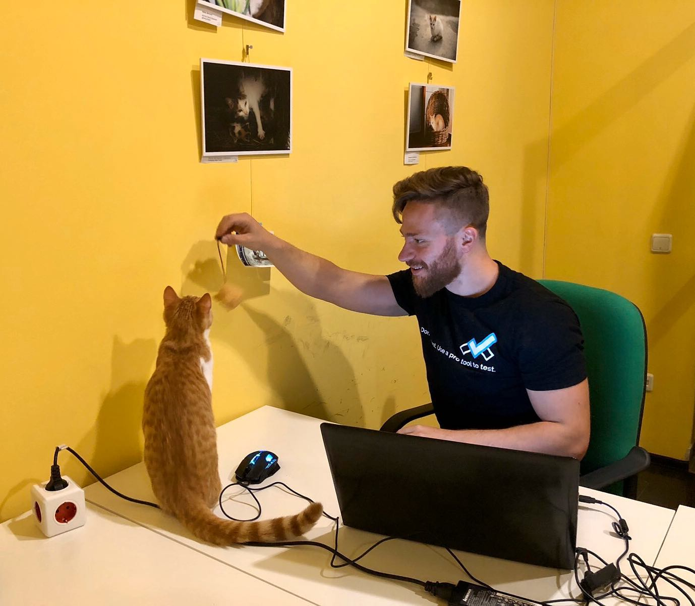
The Presenter
Ivaylo Kenov – Quality Code Advocate
Various job titles at the same time:
Organizer & Speaker @ Code It Up
CTO @ SoftUni
Full Stack Technical Trainer @ Everywhere
Code General @ https://MyTestedASP.NET
Meme Copy Machine @ Daily Programming Fun
{Insert Job Title Here}
Contacts
https://github.com/ivaylokenov
https://facebook.com/ivaylo.kenov
https://linkedin.com/in/kenov
https://www.instagram.com/ivaylokenov/
YouTube
https://youtube.com/MyTestedASPNETTV

Slide 8
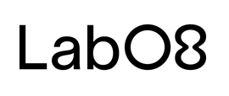
Exclusive workshop partner – lab08
Lab08 offers product development services
The company works with clients from the Scandinavian market, developing web platforms in various domains
Video-based user testing
Issuance and verification of digital credentials
Marketing through gamification and influencer-based social media marketing
When a Lab08 employee seeks development - the person can move on to a new product or domain within the company, being able to explore the product area in depth
Careers: https://lab08.com/careers/

Slide 9
Code It Up Mentorship program ON Patreon
Target – junior to regular programmers with 0 to 2 years practical work
Help with:
Becoming better software developers
Code improvement in terms of quality and logic
Career choices and advancement
Interview preparation
And more
Approach – private groups, exclusive lessons, live classes, one-on-one meetings
From 2021 – project mentorship – DDD, Microservices, CI/CD, Kubernetes, and more
More information on Patreon: https://www.patreon.com/ivaylokenov

Slide 10
What Are We Going To COVER
About Code It Up
About This Workshop
Why Software Architecture
The Architect And The Team
What Makes A Great Architect
What Is Software Architecture?
Unified Modeling Language
Designing Solution Architectures
Common Technology Stacks
Architecture Design Patterns
Choosing The Right Patterns
Architecture Quality Attributes
System-Wide Considerations
Deployment Considerations
The Architecture Document
Designing A Real-Life Solution

Slide 11
ABOUT CODE IT UP

Slide 12
Code it up
The Code It Up initiative:
Aims to provide detailed knowledge on advanced software development topics
Aimed at people with at least 1 year of C# experience
Code It Up Online
Free live-streamed online events
Led by me – mainly .NET, architecture, and infrastructure
Code It Up Guests
Free live-streamed online events
Guest speakers from the industry
Variety of technologies
Code It Up Workshop
Paid events containing theory & practical exercises for the attendees

Slide 13
Upcoming Code it up Events
Free upcoming events:
January 12 - Let's Get Functional With C#
February 13 – Enter the Swarm: Native Docker Clustering
Events with no specific order or dates:
The Limits of the C# Runtime
API Scenarios - REST, GraphQL & gRPC
Serverless Real-Time C# Applications? Yes, It’s Possible & Easy!
C# On Rocket Fuel – Writing High Performance .NET
Software Engineering – Patterns & Anti-Patterns
Let's Learn the Roslyn Compiler!
Security Considerations We Should All Know!
Plus many more!

Slide 14
Thankful if you share a story
I am super excited about this lecture!
You can be extremely helpful to Code It Up
Just share a story on Facebook or Instagram during the lecture
Make sure you tag me so that I can reshare your post - @ivaylokenov
Bonus – add the #codeitup hashtag
Thank you! You rock!

Slide 15
About this workshop

Slide 16
About this workshop
A theoretical lecture on software architectures
Widely-used design patterns in production
Depending on your level, you may be familiar with some of the topics
A real-life project example
A practical guidebook for architecting various solutions
5 real-life projects on more than 50 pages
Legacy systems, vast data load, lots of concurrent users, working with critical data, and more
Please report in the group, if you find any “bugs” in the book!
And I have a lot more to add in the future!
You receive free updates of all resources!
MOST IMPORTANTLY – HUGE THANK YOU! <3

Slide 17
About this workshop
HUGE DISCLAIMER!
There are a lot of things to know about software architectures
You may recognize some of the patterns
And we most probably will not mention all of them
The technology world is moving very fast
Some of the example shown here may be considered anti-patterns in the future
But the overall concept and process stays the same
As all my workshops – this one is super intense too!
So, give yourself time and most importantly – finish the book!
And don’t worry! The knowledge provided here will save you weeks of reading!

Slide 18
Why Software Architecture

Slide 19
Why this topic
A little back-story, first…
4-5 years ago, I was on interview for a tech lead or a software architect
Depending on my skills and knowledge
And after the interview, they told me "you are great, but you need a little bit more to become an architect"
I was both disappointed and motivated
So, I started researching a lot about software architectures and patterns
I purchased lots of courses, read lots of books
Started analyzing how the big guys are doing it – StackOverflow or Netflix, for example
This workshop is the culmination of the story above! Enjoy!

Slide 20
Why solution architects
Why do we need solution architects?
If we have a perfect tech lead?
And very skilled developers?
Consider constructing a building…
Imagine if there is no design and architecting plans
Just the workers and their team leader coming every day to work
It is the same with software development!
We need an architect to design and lead our high-level solution!

Slide 21
Reasons to become architects
It is interesting!
You will have way more variety of work to do!
You will solve different challenges!
Career path and visibility!
You will meet powerful people – CEOs and CTOs!
You learn a lot from such individuals!
Money!
Software architects may earn double the salary of senior developers!

Slide 22
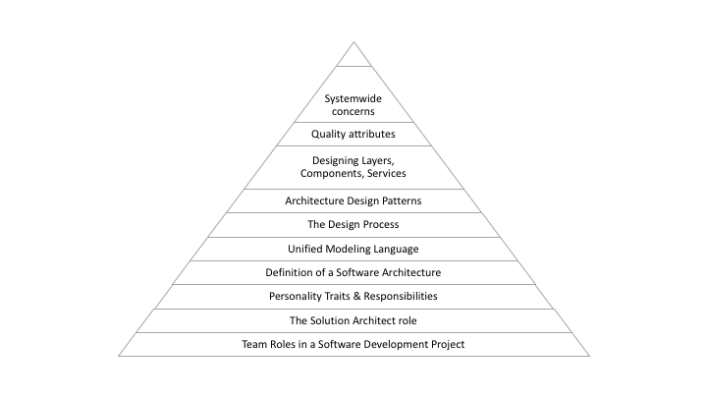
The knowledge path

Slide 23
The architect and the team

Slide 24
Principles Of Software Development
The development process is different in each company
But there is always a need to:
Understand business problem
Document non-technical business solution
Convert solution to technical architecture
Convert architecture to code
Manage developers
Test code
Deploy code
Of course, in some companies these responsibilities are mixed

Slide 25
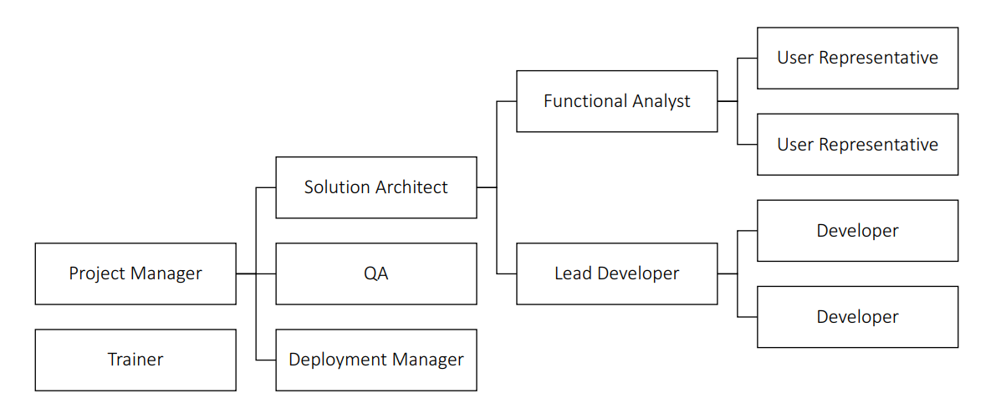
main Roles In Software Development

Slide 26
Required skills by everybody in the team
Understanding the Business
The more business understanding you have, the more useful you will be
Cross-Domain Understanding
You know bits of the other roles in the team as well
Multiple Perspectives
You need to see the problem from everyone's point of view
People Skills
Just to make sure communication goes smoothly
Lifelong Learning
IT is moving super fast; you need to stay relevant

Slide 27
Responsibilities Of The Functional Analyst
A product/project owner
Responsible for functionality
Captures, consolidates, and communicates information
Constantly asks questions:
What do you mean?
How does this fit in with…?
Etc.
Identifies and resolves conflicts
Produces requirements specification

Slide 28
Skills Of The Functional Analyst
Precise communicators
Great attention to detail
Adept at dealing with differing opinions and conflicts
Know when detail is necessary and when not
Great relationship skills
Very good listener
Can create clear and precise documents
Skilled in using Office tools

Slide 29
If you want to be Functional Analyst
Pros:
Key role
Lots of interactions
Cons:
Must work with bad user representatives
Can expect conflict
Will receive blame if functionality is missing

Slide 30
Responsibilities Of The Lead Developer
Leads and mentors developers
Assigns tasks to developers
Based on their skill level
Details and partitions work
Ensures that all developers are successful
It is not always an official role
Usually, it is the person who helps everyone else

Slide 31
Skills Of The Lead Developer
Awesome programming skills
Willing to mentor and be value-driven
Grows out of the Developer role
Requires great relationship with Architect
Wide knowledge of libraries/tools/techniques
Adept at creating technical specifications
Adept at build & configuration management
Adept at debugging, post-mortem log inspection, etc.
Can create own tools if needed

Slide 32
If you want to be Lead Developer
Pros:
Lead-in to a Solution Architect
Involves coding (optional, not necessary, but suggested)
Can pick & choose cool tasks
Cons:
Can get squeezed between the Solution Architect and the Developers
Lifelong learning required
Turns into a Developer if the Project Management is weak
Loses motivation
Team might be too small
Vulnerable to offshoring

Slide 33
Responsibilities Of The Solution Architect
Massive responsibility
Functional understanding, technical knowledge and leadership skills
Responsible for the technology stack
Converts functional requirements to a technical architecture
Carefully balances patterns/requirements/elegance/concepts
Researches key technologies
Has deep understanding of design and architectural patterns
Motivates and guides development team
Ensures that the Lead Developer is successful

Slide 34
Skills Of The Solution Architect
Grows out of Lead Developer role
Requires great relationship with Lead Developer
Always maintains helicopter view
It is not bad to help with code, but there is another role for that
Deep understanding of design patterns
Fluent in UML or other design tools
Experience with tools & code generators

Slide 35
If you want to be Solution Architect
Pros:
High value position
Great salary
Visible role
Lots of interactions
Safe from outsourcing
Cons:
Difficult to stay up to date
Difficult to get right
Can receive bad requirements
First in line to receive blame

Slide 36
Types of architects in the IT world
Infrastructure Architects
Design the infrastructure
Servers, VMs, network, storage, etc.
Familiar with requirements
Promoted from Infrastructure Expert
Solution/Software/System Architect
Responsible for the architecture of the software
Enterprise Architect
Works with top level management - CEO, CIO
Streamlines the IT to support the business
No development-oriented tasks
Promoted from Senior Solution Architect / Project Manager

Slide 37
Ideal world vs real-life
We've looked at software development team roles in an ideal world
Real-life is not exactly like that
Missing roles
Individuals with conflicting roles
Disempowered roles
Other inconsistencies
The organization itself might lack the understanding of how developer teams are supposed to function

Slide 38
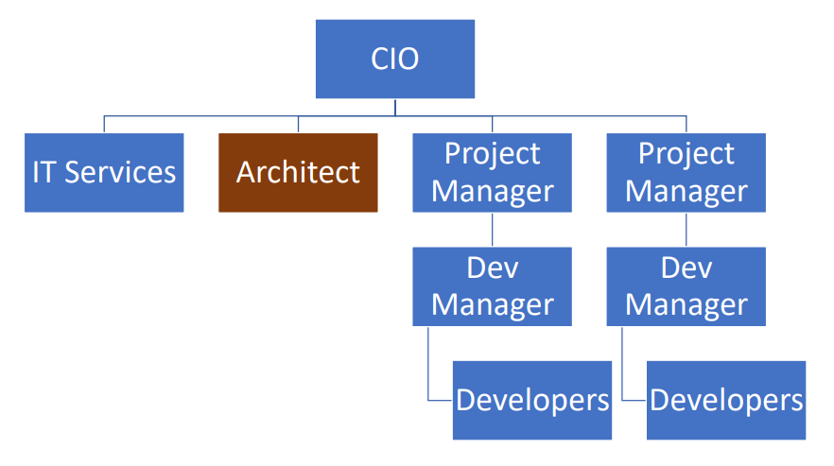
Organizational chart example 1

Slide 39
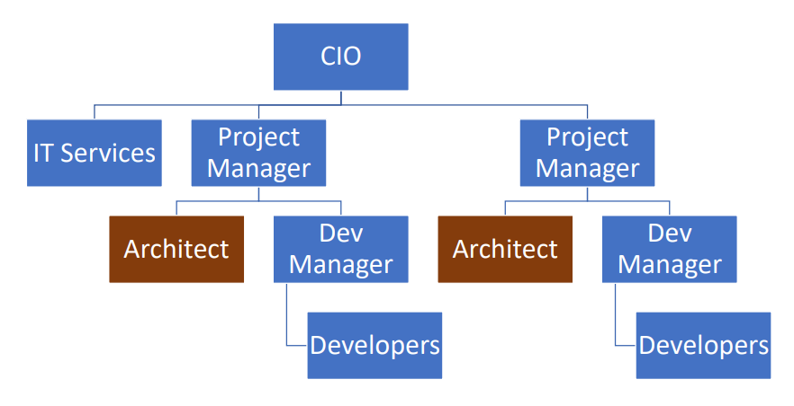
Organizational chart example 2

Slide 40
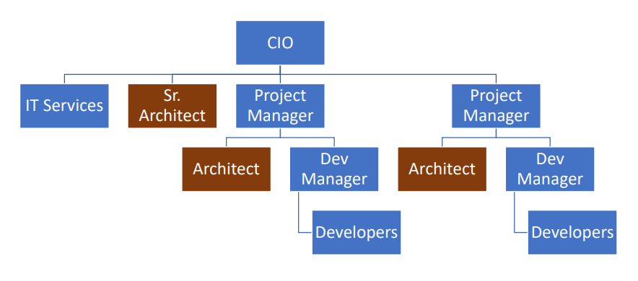
Organizational chart example 3

Slide 41
The typical ways to become architect
From Senior Developer
Usually in small companies
From Team Leader / Lead Developer
Very common path
Usually, the choice is between an Architect and a Project Manager
From Development Manager after being Team Leader
Usually in bigger companies with bigger structures

Slide 42
If you get the role
If you get a more advanced role and the organization is dysfunctional
Do not go into firefighting mode!
Resist the temptation to fix what is not working optimally
You will be swamped with work and you will never have time to fix the process
Allow the old structure to burn into the ground!
And create something better!

Slide 43
Assess you team
Think about your current team!
Are there individuals embodying more than one role at the same time?
Are these roles compatible, or is there a conflict of interest?
Is the organization knowledgeable about each role?
Is everybody aware of the importance of QA, and the need for frequent user testing?
There is nothing to be worried about though!
My team is not perfect too!
Just try to always improve the process!

Slide 44
My Team assessment
Throughout the years I was in various situations
Without any management (be my own "everything")
In a team without technical leadership
In a team with bad technical leadership
In a team with mixed roles
In a team with being every single role
In my current team, we are almost perfect
Started from having no development management
We build it to the perfect diagram without a functional analyst
I helped a lot of people grow and convinced the CEO we need to hire leaders
And I am quite happy with our accomplishment ☺

Slide 45
What makes a great architect?

Slide 46
Example Job descriptions
"Make intuitive high-level decisions."
"You will see the big picture and create architectural approaches for software design and implementation to guide the development team."
"Strong technical background and excellent IT skills."
"Experienced in designing…"
"Unified vision for software characteristics and functions."
"Provide a framework for the development of a software or system that will result in high quality IT solutions."

Slide 47
Example Real-world responsibilities
Collaborate with team to draft functional and non-functional requirements (mixed)
Use tools and methodologies to create representations for functions and UIs (architect)
Develop high-level product specifications (architect)
Define all aspects of development (lead)
Communicate all concepts and guidelines to development team (lead)
Oversee progress of development team (mixed)
Provide technical guidance and coaching to developers and engineers (lead)
Ensure software meets all requirements (mixed)
Approve final product before launch (mixed)

Slide 48
Example Requirements
Proven experience as software architect
Experience in software development and coding
Excellent knowledge of software and application design and architecture
Excellent knowledge of UML and other modeling methods
Familiarity with UI/UX design
Understanding of software quality assurance principles
A technical mindset with great attention to detail
High quality organizational and leadership skills
Outstanding communication and presentation abilities
MSc/MA in computer science, engineering or relevant field

Slide 49
Responsibilities of a great architect
There are four main groups of responsibilities
Insight
You need to understand the software development and the business domain
Leadership
You need to be able to mentor others and advance their skills
Vision
You need to understand the business and its direction
Communication
You need to be able to express yourself and defend your decisions

Slide 50
Insight
Abstract Complexity
A great architect abstracts the complexity of a system into a manageable model.
The model describes the essence of a system by exposing important details and significant constraints.
Divide a system into subsystems.
Understand Trade-offs
People want cheap, fast, quality products. You need to compromise efferently.
A great architect makes critical decisions in terms of implementation, operations, and maintenance. These decisions must be backed up by an understanding and evaluation of alternative options.
These decisions result in tradeoffs that must be well documented and understood by others.

Slide 51
Leadership
Maintain Control
Often the system starts to deviate from the initial design.
A great architect maintains control over the architecture lifecycle by continuously monitoring that the implementation adheres to the chosen architecture.
Communication with the lead developer is required.
Stay On Course
A great architect needs to be flexible and modify the architecture if challenges occur.
Not always the initial design with be technically possible.
A great architect stays on course in line with the long-term vision. When confronted with scope creep, the architect must know when to say no to some requests in order to say yes to others.

Slide 52
Communication
Explain The Benefits
A great architect works closely with executives to explain the benefits and justify the investment in the chosen software architecture.
He or she must deliver results that have an impact on the business development.
Scale better, attract more customers, sell more products, etc.
Inspire Stakeholders
A great architect inspires, mentors, and educates the team about the solution architecture.
Everyone should think that the project is awesome and cool.
All stakeholders must be able to understand, evaluate, and reason about the software architecture.

Slide 53
Vision
Focus On The Big Picture
A great architect has a holistic view and always sees the big picture to understand how the software system works.
Top level view for at least 6 months or a year ahead is required.
Act As Change Agent
Because of mixed responsibilities. Educate the company. Talk with people.
A great architect acts as an agent of change in organizations were process maturity is not sufficient for creating and maintaining the architecture.

Slide 54
Personality traits to cultivate
Steadfast
The only thing constant in Software Development is change itself. A great architect must be patient and resilient to adapt to the way stakeholders operate.
Budgets get cut. Requirements change. Technologies are deprecated. Systems go offline.
Trustworthy
A great architect conveys a sense of credibility and trust and must be perceived as successful.
An architect can attain such status by prior successful experience, formal training in the field, and by his or her ability to deliver successful and relevant results.
To grow into a trustworthy position, make sure your previous work is absolutely brilliant.
If this is your first architect job – just deliver your first versions as perfect as possible.

Slide 55
Personality traits to cultivate
Persuasive
A great architect is a skilled and diplomatic negotiator. Principled negotiation is the tactic of choice for an architect to seek cooperation with the project stakeholders.
An architect will be expected to deliver better, faster, and cheaper, but must negotiate to decide which two out of three aspects will be considered first and under what conditions.
Confident
You own this technology. If you choose a solution, be proud of it, and defend it.
You can't show your inability to deliver, even if you are insecure about it.
In a leadership position, attitude is everything. A great architect believes in his or her ability to perform.
An architect must have a passion for success.

Slide 56
Common pitfall for new architects
Most of the time, problems occur of not using "power" correctly
There are three types of power:
Implicit Power
The power which goes with your job.
You are the CEO – if you say something, people will do it, because you are in charge.
Granted Power
Everybody approaches you as the leader even though you are not formally one.
You grew as a lead naturally. The team granted you the power to be their superior.
Personal Power
The ability to absorb "punches" and recover.
Stand back to your feet after a disaster.
Every problem creates a power imbalance

Slide 57
Common pitfall for new architects
Every problem creates a power imbalance
Here are the most common issues:
The Lead Developer loses trust
Functional requirements are invalid
The planning is too optimistic
The architect role holds no power

Slide 58
The lead developer loses trust
The Solution Architect is being robbed of his implicit power
He or she wants his/her design
The Lead Developer is being robbed of his granted power
He or she wants to change the design but does not have the power
Developers are also affected by this problem
Endless discussions and implementation starts to deviate from architecture
The Solution Architect's job is to make the Lead Developer succeed!
Empower your Lead Developer
Always present a united front
Be open to feedback
Change architecture if needed

Slide 59
Functional Requirements Are Invalid
It is very difficult to realize this problem
A symptom is usually an unmotivated functional analyst
But the Solution Architect will be the one who is responsible
Executives do not understand the difference between functionality and technology
The analyst is being robbed from his personal power
He is doing a bad job, realizes it, but passes it to the Solution Architect anyway
There might be a conflict between the User Representatives and the Functional Analyst
Solution:
Find the reason – why the Functional Analyst is not doing his job correctly?
Try to restore the personal power of the Functional Analyst
Escalate up if needed – talk to the CTO or CEO

Slide 60
The Planning Is Too Optimistic
The Project Manager is responsible for this problem
And is usually unaware of it
The QA is being robbed of his personal power
"We are in a hurry, no time for testing!"
The Lead Developer is being robbed of his personal power
"There is no time for mentoring, training and reviews, just keep pushing code!"
Solution:
Bring the Project Manager in on the dev team
Find the reason! Optimistic PM? Naïve Lead Developer? Slow Developers?
Coach Lead Developer, Restructure Developers, Readjust schedule, Alter planning

Slide 61
The Architect Role Holds No Power
The Project Manager and Functional Analyst see the Software Architect as a producer of documentation
The Software Architect is being robbed of implicit power
No communication and no leadership
The organization does not understand what an architect should do
The project will most probably fail
"We are in a hurry, no time for testing!"
Solution:
Educate the C-section, be a change-maker
Team up with Project Management, QA, Functional Analyst, and Lead Developer
Become the owner of the entire process
Leave if the organization is unwilling to change

Slide 62
Architects should understand the business
Every architect should understand the business very well
Weaknesses
Strengths
Competition
Growth strategy
Every architect should understand the system goals
Goals are not requirements
They are not "what the system should do"
Goals describe the effect on the organization
They are usually described by a client
Think about the big picture
Work for your client's clients

Slide 63
System goals examples
HR system
Organization – product-oriented company
Goal – streamline the recruitment process
Reporting & mapping criminal incidents system
Organization – large city
Goals
Improve police response time
Attract new residents
Mobile flash sales system
Organization – small startup
Goals
Generate quick revenue stream
Attract investors

Slide 64
Architects should watch their language
With Project Managers – they care about project success and budgets:
Avoid:
Use:
"This is the latest and greatest pattern, and we'll be the first to test it out! We can write a blog post about it!"
"This new technology can help us write the code twice as fast, so we can cut our schedule and budget accordingly!"

Slide 65
Architects should watch their language
With Lead Developer – they care about code and technology:
Use:
"Have you heard about the latest React version? We’re going to use it!"

Slide 66
Architects should watch their language
With CEO/CTO – they care about financial bottom line:
Avoid:
Use:
"Any technical buzzwords/mumbo-jumbo…"
"The architecture I've designed will ensure the continuity of the business, and will be able to cope with the high loads expected during Black Friday sales!"

Slide 67
Soft skill required
Listening
Sounds easy, but it is not. Consider the person you are talking to!
Never think you know all about technology! I learnt new tricks from this workshop too!
Assume you are not the smartest person in the room!
Collective wisdom is better than individual one!
Dealing with criticism
Your work is going to be criticized! You will be asked to explain the logic behind your decisions!
Don't attack back! It will put you in a bad position!
Consider the reasons:
Genuine questions – provide facts and logic. It is OK to say "Good question, let me think about it!"
Mocking you – think about the "why" here, but never get offended. It is not you, it's probably them!

Slide 68
Soft skill required
Be smart, not right!
For example – you are presenting your architecture in front of the CTO and senior experts
And somebody questions your design in a calm and professional manner:
"I believe the stateless pattern is useless here. It will hinder the performance!"
You know you are right, but do not attack back
Your goal is to get an approval of the architecture
So, don't do the thing to make you feel right. Don’t say:
"You are wrong. The system is under heavy load. The stateless pattern will help us with that!"
Instead, answer smartly to get everyone's approval:
"That's a great point. We actually had a lot of thinking about this specific issue, and we believe this is the better option. Let's have a further meeting to discuss it in more detail?"
This way you got more respect and avoided a long and boring technical argument (and most probably the meeting afterwards)

Slide 69
Soft skill required
Deal with organizational politics
We all want patterns and code, but you must cope with the politics
For example, the CTO of the project doesn't want to do microservices:
"It's new, untested, and immature pattern. It is too risky!"
No matter the case studies we provide him, he refuses to accept microservices
So instead of searching for technical solutions, try to understand the situation
It turns out the CTO is going to be replaced soon and he is just rejecting everything
So, a better approach is to prepare the future CTO and discuss the patterns with him
Being aware of organizational politics, but never be part of them!
It may give you short-term leverage, but in the long-term, it will hurt you badly!

Slide 70
Soft skill required
Public speaking
Architects have no formal authority
They do not take the final decision
Therefore, you can influence using speaking skills
You will be part of many meetings
You must be able to stand in front of an audience and present your solution
Here are the main concepts:
Define a clear goal
Know your audience
Be confident or pretend it
Don't read the content from slides
Maintain eye contact
Take a course on public speaking. It is very important skill!

Slide 71
Soft skill required
Constant learning
The development world changes in a blink of an eye
Always keep learning
A lot of frameworks get completely forgotten in months
Consider jQuery or Grunt
Some of you may have never used it!
Angular is also dying right now
There are better alternative – React, Vue, the new kid Svelte
You may not like that, but keep adapting
You do not have to know the tools in detail
That's the developer's job
You should know when and why to use a tool
Main source – blogs, books and webinars

Slide 72
Assess Yourself
Find your personality traits
There is a good test for that
16 Personalities - https://www.16personalities.com/
Great architect is that it requires somewhat incompatible personality traits
You need very strong intuition, insight, and vision
Introvert-Analytical personalities are quite strong in that area
But you're also going to need strong communication and leadership skills
This requires an Extrovert-Feeling personality
Find your weaknesses in the 4 architect skills
Insight, Leadership, Vision, and Communication

Slide 73
My assessment
My test resulted in Assertive Commander
Like Steve Jobs, Gordon Ramsay, Jim Carrey, Dr. Strange, and others
I love good challenges and achievements
I have ruthless level of rationality
But I overwhelm the more sensitive people
Strength – efficient, energetic, self-confident, strategic, inspiring
Weaknesses – stubborn, impatient, intolerant, arrogant, emotionless
Perfect career path
Executive positions or entrepreneurship
I crave responsibility, growth, and opportunity
Remember the back story?

Slide 74
Assess Yourself - Communication
Bad communication habits:
Criticism – do not criticize without valid arguments and background knowledge
Contempt – do not underestimate people and their abilities
Defensiveness – do not attach yourself to your own solutions and designs
Stonewalling – being stubborn about everything you do not believe in
Remember that you want to inspire and motivate the people around you
You can only accomplish this with healthy, powerful, and uplifting communication
You can try the questions from the provided document
Think how you can improve yourself!

Slide 75
Assess Yourself - Leadership
Leadership is tricky business. You need:
Socio-Political Power – how you present yourself unconsciously
Positional Power – what is current position in a group or organization (paid or unpaid)
Informal Power – what power the other people give you "by default"
Historical Power – growing up, childhood and teen years
Personal Power – make friends, cope with challenges, bounce back from setbacks
You can try the questions from the provided document
Think how you can improve yourself!

Slide 76
My assessment
Throughout the years, I've dealt with all of it
Criticism, contempt, defensiveness, and stonewalling
I learnt with time how to solve these personal issues
Mainly by thinking about them during various situations
I also worked hard for my power
Socio-Political Power – I was never the "cool" guy, so I started doing "cooler" things that I like
Positional Power – I always accepted challenges and learnt on the fly (remember the back story?)
Informal Power – I always try to help and mentor others or at least point them in a direction
Historical Power – anxiety, shame, getting bullied, hard to recover from these
Personal Power – had a great depression 3 years ago after a huge failure

Slide 77
What Is Software Architecture?

Slide 78
Software architecture
Structured solution to address all common software attributes:
Meets all the requirements
Performance optimized
Security in check
Manageability for developers
Scalability for business growth
Accessibility for easier user experience
Major requirements:
User requirements – the way end-users interact with the system
Business requirements – cheaper, faster, better than competitors
IT system requirements – infrastructure requirements

Slide 79
What composes an architecture?
The structural elements and interfaces composing the system
Objects – the low-level building blocks of the system
How these elements behave in collaboration
How communication is done in the architecture
The composition of elements into larger subsystems
How the elements are mapped to trees or graphs – the high-level data structure
The architectural style that guides this composition

Slide 80
What composes an architecture?
Additionally, our design should cover:
Functionality
Usability
Resilience
Performance
Economic and technology constraints
Trade-offs and aesthetic concerns
The goal is to:
Document high-level structure
Do not go into implementation details
Minimize complexity
Address all requirements
Be compatible with all use cases and scenarios

Slide 81
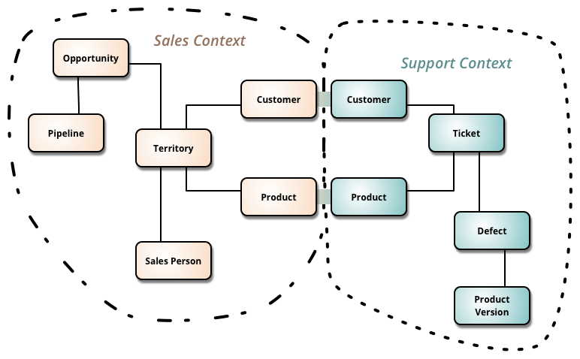
Our architecture needs
Separation of Concerns
Encapsulation
Dependency Inversion
Explicit Components
Single Responsibility
Don’t Repeat Yourself
Persistence & Infrastructure Ignorance
Presentation Ignorance
Bounded Contexts
Testability

Slide 82
Architecture abstraction
Layers:
System, Sub-systems, Layers, Components, Classes, Data and Methods
Bad Architecture:
Complex, Incoherent, Brittle, Untestable, Unmaintainable
Good Architecture:
Simple, Understandable, Flexible, Testable, Maintainable

Slide 83
Software Architecture Design Tips
Build to change instead of building to last
You are going to change your solution multiple times
Create around modularity and flexibility
Use models, but only to analyze and reduce risk
The models should be more abstract, otherwise you are taking the role of a developer
Use visualizations to communicate and collaborate
Your architecture is going to be a large diagram
Identify and research critical points of failure
Put in work in research in everything advanced
Security, scalability, resiliency

Slide 84
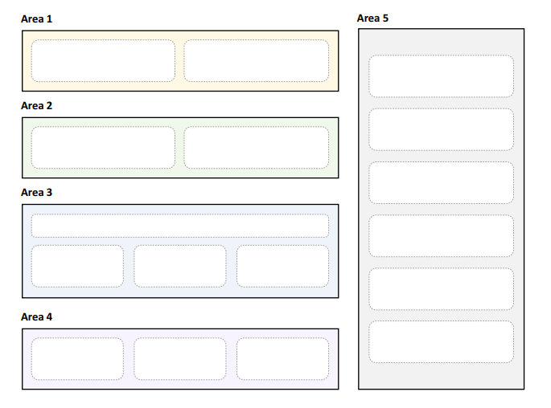
Areas Of Software Architectures
The goal of a software architect is to minimize complexity
This can be accomplished by separating the design into different areas of concern
Also known as modules (or components)

Slide 85
Key Principles Of Software Architectures
Separation of concerns
Each object and module should be in its own concern and context
Single responsibility principle
Elements in our design must have a single purpose
Principle of least knowledge
Components do not know about the internals of other components
Done through interfaces
Don’t repeat yourself
Don't have multiple components with the same purpose
Minimize upfront design
Try to design the minimum architecture so that developers can work
You will polish the next sections later

Slide 86
General Guidelines
Use consistent patterns in each layer
If you decide to use MVC pattern in the presentation layer – stick to it
If you use CQRS in the application layer – stick to it
Do not duplicate functionality
Do not have a caching component in all layers
Prefer composition over inheritance
It is complicated to create huge hierarchies
Work with the Lead Developer here
Establish a code convention
Define the code style and preferably automate it
Work with the Lead Developer here

Slide 87
Layer Guidelines
Separate areas of concern
Each layer should have one role only
Define communication between layers
How does the presentation layer communicate with the business layer?
Use abstraction to loosely couple layers
Use interfaces for every communication
Objects should not be tight to a particular platform or technology
Don’t mix different types of components in a layer
Use a consistent data format within a layer

Slide 88
Component Guidelines
No component should rely on the internals of another
Components should be black boxes
Do not mix roles in a single components
Web controllers should not have business logic
Business layer should not have HTTP concerns
Define clear contracts for components
All public methods and properties should be scoped in advance
Abstract system wide components away from other layers
As soon you have a component which is accessible in multiple layers
Put it in a system-wide area of concern

Slide 89
Unified Modelling language

Slide 90
What is UML?
From Wikipedia:
“A general-purpose, developmental, modeling language that is intended to provide a standard way to visualize the design of a system”
Main attributes:
Visual – it is easy to see the representation of the architecture
Abstract – it stays away from implementation details
Descriptive – shows the complete representation
Standard – UML is the world standard
Supports Code Generation – specific sections can be converted to code
Supports Reverse Engineering – create UML from code
You should know it in case the client wants it
But can easily avoid it

Slide 91
UML design elements
Models
Container for the design
Are you looking at the entire system? A subsystem? A feature?
Views
A way to look at the system
Is it an external view? Or the internal structure?
Diagrams
Specific drawings that illustrate the architecture

Slide 92
UML Model Types
Business System Model
Non-technical model
External View
Looking at the system as a black box
Internal View
A lot more details
IT System Model
Specifically looks at technology
Static View (Structure View)
How the different elements fit together
Dynamic View (Behavioral View)
How these elements call each other

Slide 93
UML Diagram Types
Component Diagram
Class Diagram
Sequence Diagram
State Diagram
Activity Diagram
Layer Diagram
Use Case Diagram
There are others...

Slide 94
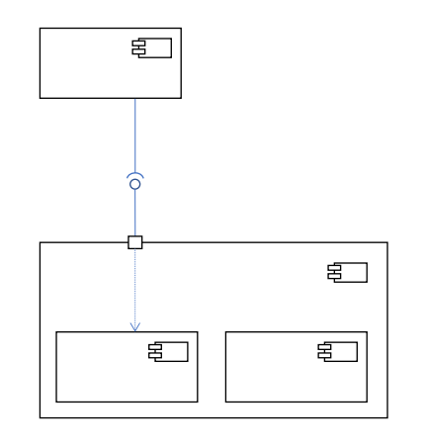
The Component Diagram
Shows components
Modular building blocks
Shows implemented and required interfaces
Components can be nested
If you decide to describe your architecture with a component diagram, you will have a very descriptive image

Slide 95
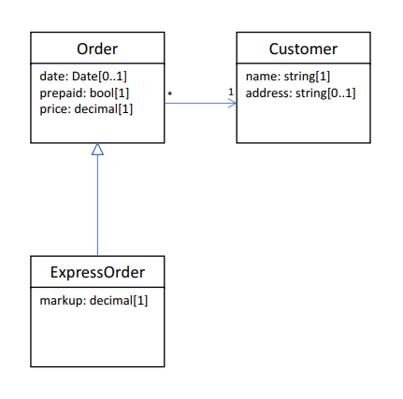
The Class Diagram
Shows classes
Shows methods and fields
Shows associations, generalizations, and cardinality
Quite detailed in terms of implementation

Slide 96
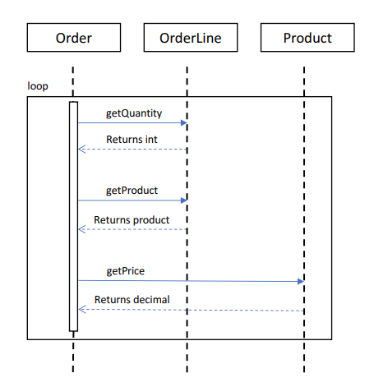
The Sequence Diagram
Shows call sequence
Shows calling class, called method, and return data type
Can depict loops

Slide 97
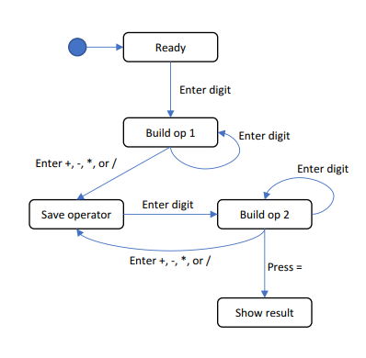
The State Diagram
Shows states or activities
Shows allowed transitions
Can be nested
Can depict internal activities

Slide 98
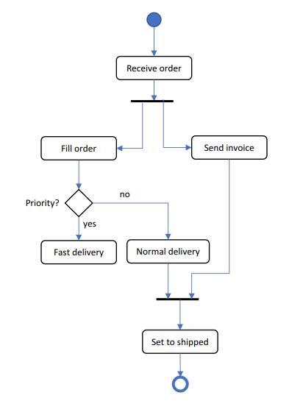
The Activity Diagram
Shows process or workflow
Like the famous flow charts
Can be nested
Can show concurrent actions
Can have swim lanes

Slide 99
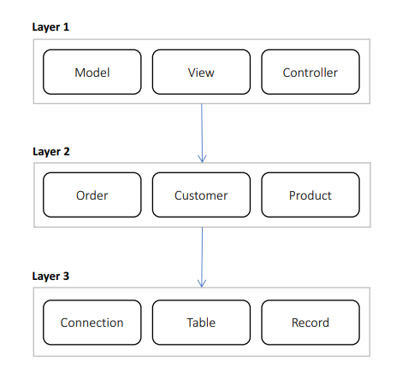
The Layer Diagram
Non-standard, invented by MS
Shows areas of concern
Shows references between areas
Can be validated

Slide 100
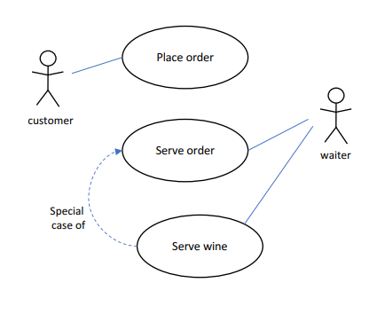
The Use Case Diagram
Shows actors
Shows use cases
Binds actors to use cases
Can depict generalizations

Slide 101
Designing Solution Architectures

Slide 102
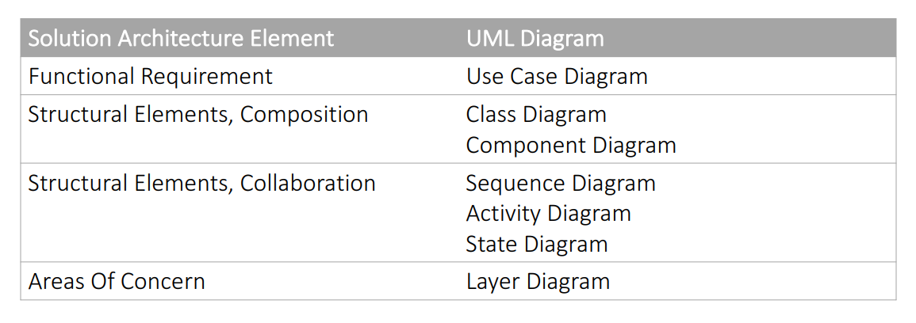
UML Diagrams In Architectures

Slide 103
UML Design Strategies
UML as Sketch
Intended for brainstorming and general loose guidelines
UML as Blueprint
Very detailed, you can write code based on the diagrams
Forward Engineering - use diagram to generate code
Reverse Engineering - build diagram from existing code
UML as Validation
Validate implementation against diagram

Slide 104
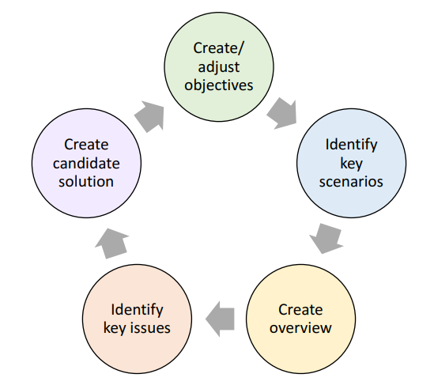
The Process For Designing Architectures

Slide 105
Create Or Adjust Objectives
Identify scope of architecture
What are the high-level objectives and requirements?
New technologies? Server? Client? Proof of concept?
Estimate time to spend
Do you have months? Do you have weeks?
Identify audience
CEO? Developers? Functional Analyst?
Identify technical, usage and deployment constraints
What are the available technologies?
How many people use the system simultaneously?
How many servers do you have? Cloud? On premise?
These requirements are super important!

Slide 106
Identify Key Scenarios
Key scenarios:
Significant unknown/risk – promo codes on scale
Significant use case – payments integration
Intersection of quality/function – clashing of these two attributes
Tradeoff between attributes – consider the trade offs
Significant use cases:
Business-critical – part of the core business domain
High impact – very important for the end-users
Create Use Case Diagrams

Slide 107
Two types of requirements
Functional
Business flows
What the user should do
User interfaces
And many more…
Non-functional
Performance
Load
Data volume
Concurrent users
SLA
These are the most common ones

Slide 108
Performance requirements
"What is the required performance of the system?"
"SUPER FAST!"
Always talk in numbers!
For example, if you have an end user – each task should complete in less than a second!
Think about latency
How much time does it take to perform a single task?
How much time will it take to store a user in the database?
Think about throughput
How many tasks can be performed for a given time unit?
How many users can be saved in the database in a minute?

Slide 109
Performance numbers Example
Let's say we have a task
Storing a user in database
And its latency is 1 second
This is quite slow, but it is just a demonstrational number
What is the throughput for 1 minute then?
In a well-designed system – more than 1000 users
In a badly designed system – around 60 users
Both attributes are important!

Slide 110
Load requirements
Load is quantity of work without crashing
In a Web API – how many concurrent requests could the server handle without crashing
Difference with throughput:
Throughput – 100 requests/second
Load – 500 requests without crashing
Users can tolerate a bit slow system
But they hate crashing ones!
Best practice is to always plan for the most extreme cases!
For example – Black Friday in an e-commerce site!

Slide 111
Data volume requirements
How much data the system will accumulate over time
This requirement dictates:
The database type
Designing queries in the database
Storage planning
Two aspects:
Data required on "day one"
For example – initially we need 1 GB of data
Data growth
For example – our database grows annually with 2 TB of data

Slide 112
Concurrent users requirements
How many users will use the system simultaneously
It is different than the load requirements
Concurrent users have "dead times"
They read the page, watch something on it, but do not make requests
Load requirements consider the actual requests
The rule of thumb is to take the load requirements
And multiple them by 10!
But this depends on the system type

Slide 113
Service Level Agreement requirements
What is the required uptime for the system in percentage
For example, 99.99% uptime
This is translated to ~1 hour of downtime in a year
It would be quite impressive!
It is the solution's architect to manage the clients' expectations
If the expected uptime is 99.999%
Just tell them that we will need at least five different data centers
On independent continents
With variety of power supplies
And multiple Internet providers
This answer usually brings them down to Earth ☺

Slide 114
Who defines these requirements?
The Functional Analysts and the CEO usually provide a well documented business and functional requirements of the system
But who defines the non-functional ones?
It is the Solution's Architect job to frame them
By starting discussions
And asking the right questions
And keeping the expectations realistic and meaningful
There is no need to fight for every millisecond
The users will not notice that
Never design a system without the non-functional requirements!

Slide 115
Create Application Overview
Determine application type
Bot? Console? Service? Web? Desktop? Maybe Serverless?
Identify deployment constraints
Where are you going do deploy the application?
Identify architecture pattern
Layered? Component? Microservices?
Determine technologies
What technologies are available? Libraries? Third-party tools?
A lot of factors play here… Choose wisely!
Create a Layer Diagram

Slide 116

Application Types – Web application
Best suited for:
User interface
User initiated actions
Large scale
Short, focused actions
Request-Response based

Slide 117
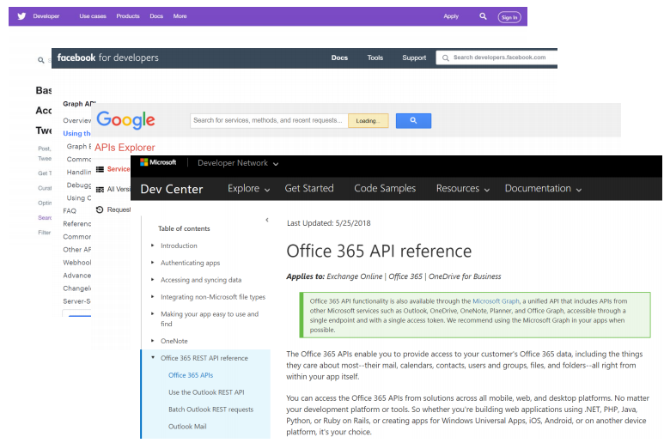
Application Types – Web API
Best suited for:
Data retrieval and storage
Client initiated actions
Large scale
Short, focused actions
Usually REST based
Returns data, not HTML
Combination of:
URL (https://www.mysite.com/api/orders)
Parameters (date=10/10/2017)
HTTP Verb (GET)

Slide 118
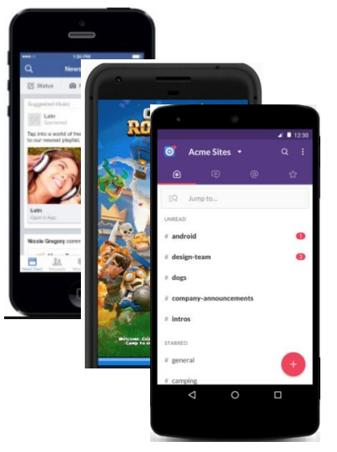
Application Types – Mobile Application
Best suited for:
Well, mobile devices ☺
User interaction (games, social apps)
Front end for Web API
Location & camera-based systems
Usually work with a Web API

Slide 119
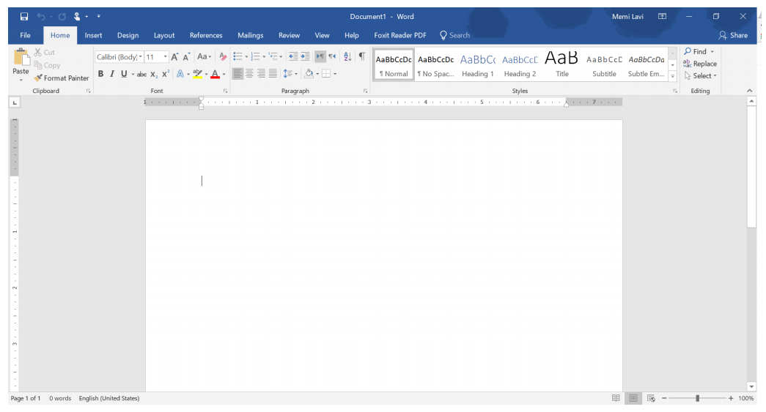
Application Types – desktop Application
Best suited for:
User centric actions
Gaming
Has all its resources on the local PC
Might connect to the web
Great UI

Slide 120
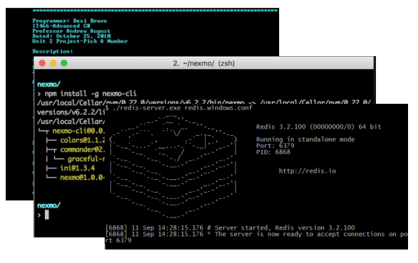
Application Types – Console Application
Best suited for:
Long-running processes
Short actions by trained power-users
No fancy UI
Require technical knowledge
Limited interaction
Long or short-running Processes

Slide 121
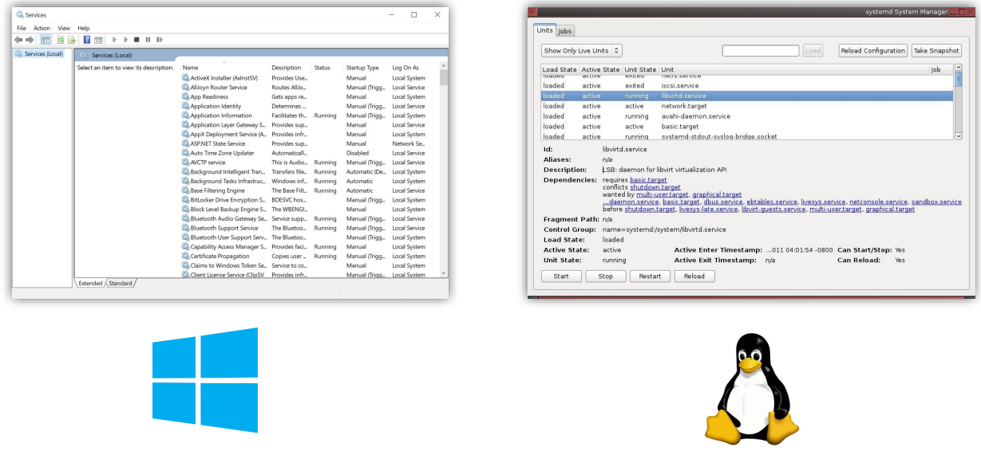
Application Types – Service
Best suited for:
Long-running processes
No UI at all
Managed by the OS service manager

Slide 122
Selecting technology stack
This is a super important decision
Mostly because it is almost irreversible
And developers get emotional to their favorite tools
The decision must be:
Made with a clear mind, heavily documented and based on a group effort
Main considerations besides performing the task:
Community – check Stack Overflow
Popularity – check Google Trends
Current developer skills – unknown technologies produce delay and low quality
Deadline – advanced technologies take more time
Support – developers should develop, be careful with shiny new tools
Products – use external and existing tools but always estimate the cost

Slide 123
General tips and tricks
Do not choose on recommendation
Or marketing tricks
Always do a pros/cons list
Which type system – static or dynamic?
What is our infrastructure?
Is the community using the tool?
Is performance critical?
Do we need to analyze the learning curve?
Can you easily hire a new team member?
Stay rational and don’t argue with your colleagues!
Use the right tool for the job!
And not vice-versa!

Slide 124
popular technologies
Web applications – back-end
Mature - .NET, Java, PHP
Newer - Node.js, Python, .NET Core, Go
Serverless – Amazon Lambda, Azure Functions
Web applications – front-end
HTML, CSS & JavaScript (or maybe Web Assembly, if you are adventurous)
Which JavaScript framework? Angular? React? Vue? Svelte?
Mobile applications
Native? Hybrid? Cross-Platform?
The battle is development time versus capabilities
Desktop applications
WinForms, WPF, UWP

Slide 125
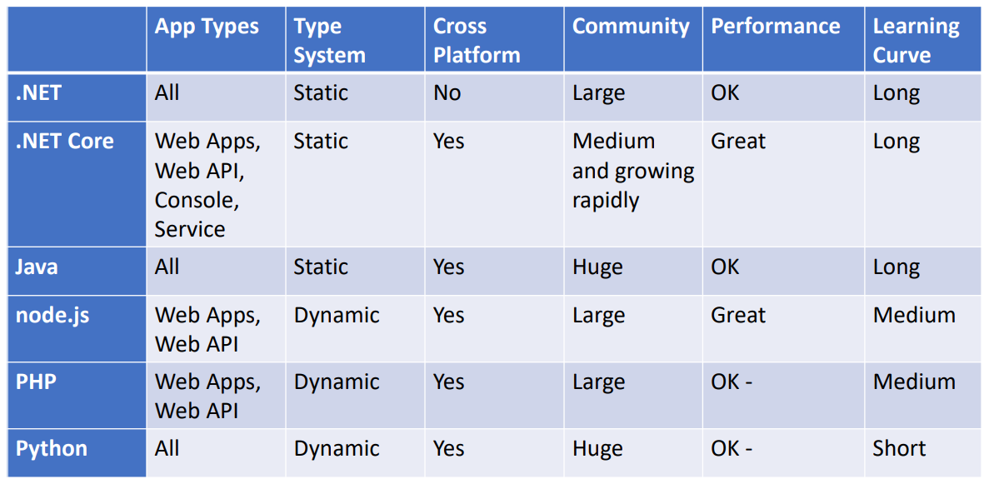
Back-end and service Technologies

Slide 126
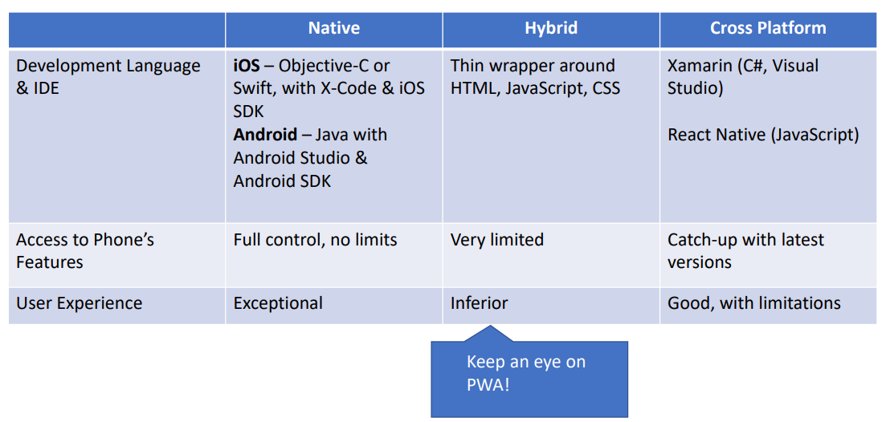
Mobile technologies

Slide 127
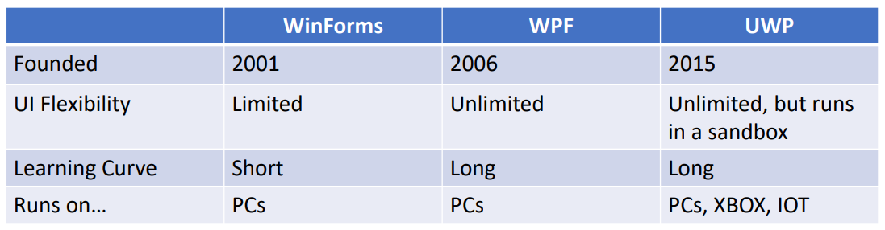
Desktop technologies

Slide 128



database technologies
Key-value
Useful for cache, publish/subscribe, leaderboards
Not your primary database
Redis, Memcached
Wide column
Each key has multiple columns without a schema
Cannot do joins and scales easily
Useful for time-series (IoT), historical records, high-write/low-read scenarios
Not your primary database
Cassandra, HBase

Slide 129


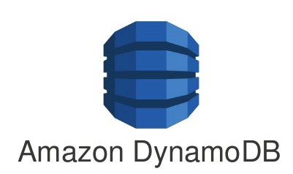
database technologies
Document
Each document is a container for key-value pairs
Fields can be indexed
Columns can be collection – query relational data without joins
Reading data is usually super fast, but writing data tends to be more complex
General purpose – applications, games, IoT, content-management
If you have unstructured data – a document database is a great start
No standard language for queries
Not suitable for huge graphs of data – social networks, for example
MongoDB, Firestore, DynamoDB, CouchDB

Slide 130



database technologies
Relational
Tables are connected through relationships
Requires a schema
ACID compliant – atomicity, consistency, isolation, durability
Good for stable data
More difficult to scale
Supports SQL – a query language
General purpose - perfect for most applications which does not have unstructured data
Some databases support JSON columns
MySQL, PostgreSQL, SQL Server
Modern databases like CockroachDB – designed for scale

Slide 131


database technologies
Graph
Data is represented as nodes
Relationships between the nodes are edges
Instead of many-to-many tables, you have direct connections
Languages like SQL
Better performance than relational databases when datasets are large
Useful for – recommendation engines and well… graphs
Neo4j, CosmosDB

Slide 132


database technologies
Search engine
Full-text search engine
Like document databases but under the hood all the text is indexed
Works like an index at the back of a book
Can easily rank results
Useful for search engines and typeahead scenarios
Elasticsearch, Algolia, MeiliSearch

Slide 133

database technologies
Multi-model
You do not think about data modeling, schemas, shards, replications
You describe how you want to use the data with GraphQL
It chooses the database type behind the scenes
ACID compliant, extremely fast and you do not care about provisioning infrastructure
Useful for… everything?
FaunaDB

Slide 134
Identify Key Issues
Quality attributes:
System, run-time, design, user
Performance, stability, manageability, configurability, etc.
System wide concerns:
Authentication & authorization
Caching
Communication
Configuration management
Logging & exception management
Validation

Slide 135
Create Candidate Solution
Create a Baseline architecture
Create a Candidate architecture
Develop Architectural Spikes
Proof of concept projects to validate unknown concepts
Create Activity, Sequence, State, and Component Diagrams
Create Class Diagram if needed
They are too low-level
Document only the most important classes
Everything else should be done by the Lead Developer

Slide 136
During Each Cycle
Do not introduce new risk
Do not introduce untested technologies and concepts
Mitigate more risk than baseline
Each cycle should reduce the risk
Meet additional requirements
Cover more and more requirements until you meet them all
Enable more key scenarios
Address more key issues
Start communicating architecture when you exceed 50% coverage
If you have the feeling you are half done, invite the developers
You don't want to be the bottleneck

Slide 137
a sample project

Slide 138
Learning system
Here are our business requirements from the Functional Analyst:
A student visits the solution and logs in. He or she is presented with a list of courses. When a student clicks a course, he or she is taken directly to the last visited lecture in that course. The lecture detail page has 3 panels and shows the curriculum on the left, the lecture contents in the middle, and a Q & A panel on the right. The student can use the curriculum to navigate to different lectures and submit questions to the instructor in the Q & A panel.
An instructor visits the solution and logs in. He or she is presented with a list of courses. When the instructor clicks on a course, he or she is taken directly to a course management page. The page shows all questions in the course, with the unanswered questions highlighted. By clicking on a question, the instructor navigates to a new page where he or she can answer the question.

Slide 139
Learning system
And here are our business requirements from the CTO:
Basically, our key attributes are:
Performance
Availability
Scalability
Lectures need to load in 1 second or less. Performance is key, our USP is to be the fastest platform in the business, and our students and instructors will abandon our platform if we are too slow. We also cannot afford to be offline. Every hour we are offline would cost our business thousands of dollars in lost revenue. And we want to scale to millions of students, the platform must be able to accommodate for that with ease.

Slide 140
initial design
We have not learned about architecture patterns yet
So, it's a bit premature to start creating a detailed design
But we know about the process and can get started with our initial diagrams
Our tasks for now are in the first 3 steps of the design process:
1a. What are our objectives? What are our scopes?
1b. Who is the key audience? Any constraints?
2a. What are the key business scenarios? Create a Use Case diagram.
2b. Create an Activity diagrams for the student and the instructor.
3a. Think about the architectural overview. What is the application type?
3b. Decide the technology stack. Back-end? Front-end?
You can use https://draw.io or https://lucid.co/product/lucidchart for the diagrams

Slide 141
Scope and objectives
The scope of this architecture contains:
Login screen for both student and instructor
Student interface for listing courses
Watching course lectures
Q & A panel for submitting questions
Instructor interface for listing courses
Course management page
Q & A panel for answering student questions
Time schedule – 1 week
Audience – CTO and Developers
We can easily include technical stuff

Slide 142
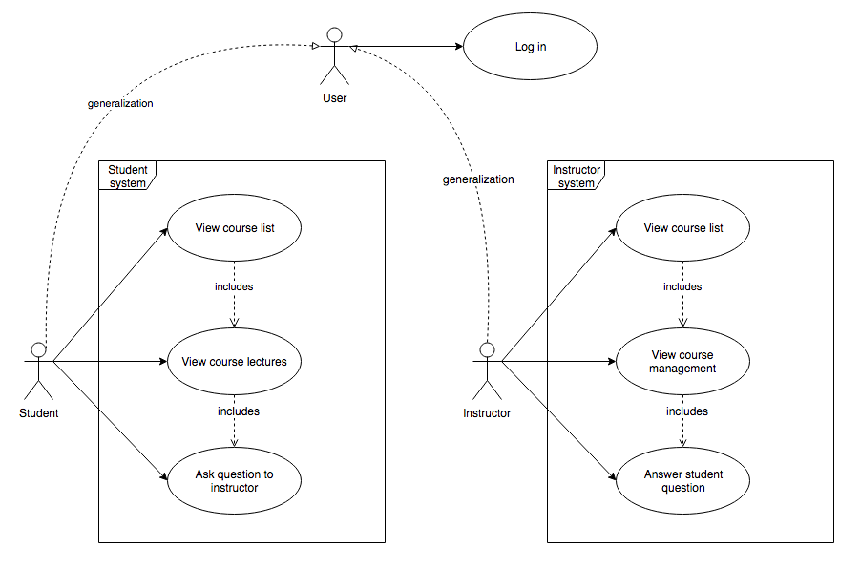
key scenarios Use case diagram example

Slide 143
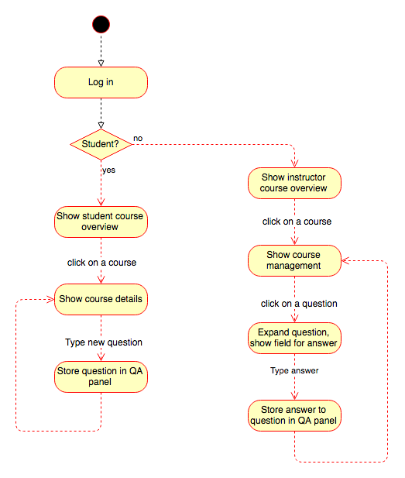
key scenarios activity diagram example

Slide 144
Technology constraints
We are building the solution from scratch
We choose technologies based on our and the developer skills
There is no need to introduce an unfamiliar stack – it will increase the expenses of the project
If you are still building the team – you can experiment a bit more
I am proficient with .NET and JavaScript
And my team is consisting of very skilled .NET developers
My technology stack will be Microsoft oriented
We want millions of students and huge availability
On premises servers will require huge maintainability
We are going to use a public cloud
Azure is the perfect choice for Microsoft technology
But consider the other options as well – they may be cheaper

Slide 145
technology options
Back-end technology options:
ASP.NET Core REST API – requires heavy server-side architecting
Serverless with Azure Functions – less architecture burden but less overall control
Front-end technology options:
ASP.NET Core MVC
Server-side rendering is not very suitable for interactive applications
ASP.NET Core Razor Pages
Less overhead in terms of the client
Blazor
Way too new and experimental but the developers may want the bleeding edge
React or Vue
Depends on the knowledge of the developers

Slide 146
Architecture design patterns

Slide 147
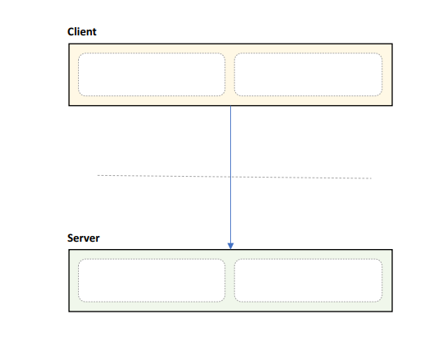
Client/Server Pattern – Layered
Distinct client and server
Separated by network
Communication protocol
Many clients, one server
Pros:
Secure & Simple
Centralized Control
Easy to manage
Cons:
Requires network, difficult to scale
Single point of failure

Slide 148
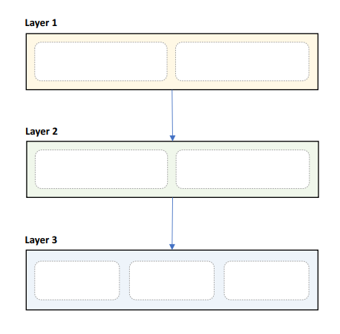
Layered Pattern – Layered
Strict areas of concern
Layers may only communicate with peers above/below
Pros:
High abstraction & High isolation
Structured communication
Easy to scale out
Cons:
Deep call chains
Can hide complexity
May harm performance
Lowest layer must cover all use cases

Slide 149
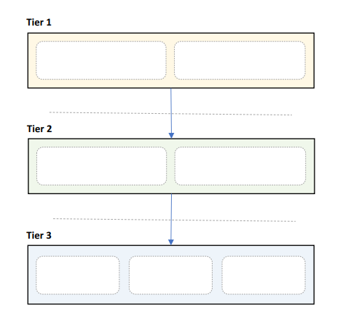
N-Tier Pattern – Layered
Layers deployed to servers
Usually - 3 tiers, always start with them
Communication between layers uses network
Pros:
High abstraction & High isolation
Structured communication
Easy to scale out
Cons:
Network = point of failure
Network may be slow
Coarse interfaces
Hard to debug

Slide 150
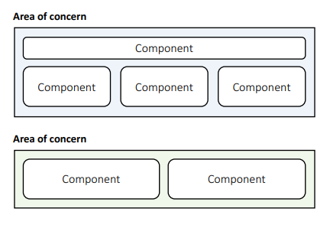
Component-based Pattern - Structural
Components are modular building blocks of software
Grouped into areas of concern
Clearly described interfaces
Containers provide additional services
Pros:
Easy deployment & Allows 3rd party tools
Promotes modularity & Few unanticipated interactions
Cons:
Coarse building blocks & Can be expensive
Initialization may be slow & Harder to develop & maintain

Slide 151
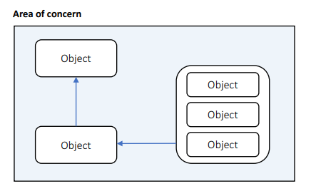
Object-Oriented Pattern - Structural
Uses classes
Grouped into areas of concern
Describes public members
Uses inheritance, composition, aggregation, and associations
Pros:
Easy to understand & Promotes reuse
Easy to test & debug & Highly cohesive
Cons:
Inheritance hard to get right & Useful only if you do not have a Lead Developer
Many unanticipated communications & Too detailed

Slide 152
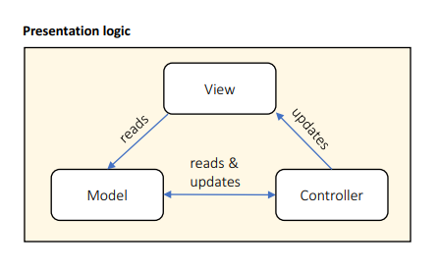
MVC Pattern - Presentation
Designed for presentation layers
View handles output
Model handles data
Controller handles interaction
Pros:
Strict separation of concerns
Scales well
Cons:
High overhead
Scattered code
Hard to data-bind

Slide 153
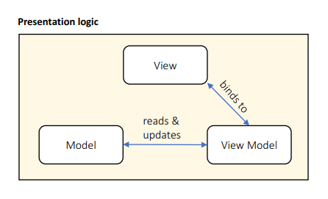
MVVM Pattern - Presentation
Derived from MVC pattern
View handles output
Model handles data
View Model is binding source
Pros:
Strict separation of concerns & Scales well
Easy to data-bind
Cons:
High overhead
Scattered code
Controller not separated

Slide 154
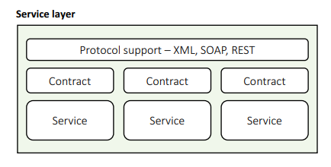
Service-Oriented Pattern - Service
Discrete business services
Use network to communicate
HTTP, XML, SOAP, Binary…
Pros:
Business domain alignment & High abstraction
Discoverable, resilient, Allows 3rd party libraries & Cross-platform
Cons:
Clients must handle slow, offline network
Coarse interfaces
May harm performance
Security issues

Slide 155
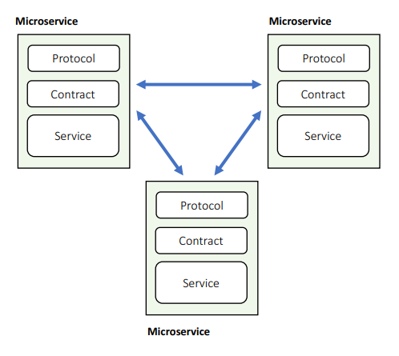
Microservice Pattern - Service
Services calling services
Can use fast private network and RPC
Deployed on multiple servers
Pros:
Modular & Reduced abstraction
Discoverable, resilient & Less coarse interfaces
Can use fast network
Cons:
Must cope with slow, offline network
More unanticipated communications
Hard to do transactions & Hard to test, debug, deploy

Slide 156
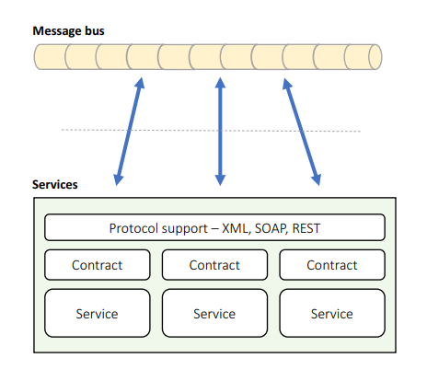
Message Bus Pattern - Service
Services connected to shared data bus
Uses messages for communication
Supports discovery, failover
Pros:
Easy to extend & Simple communication
Very flexible & Easy to scale
Easy discovery, failover
Cons:
Bus = single point of failure
Coarse communications
Can be slow & Hard to test, debug

Slide 157
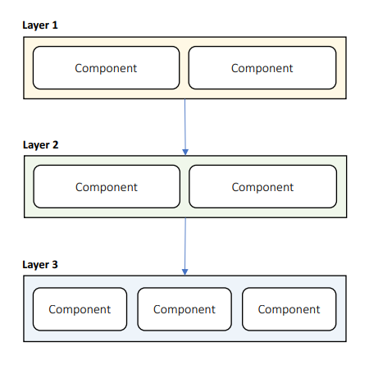
Components In Layers - Hybrid
Layers containing components
Benefits of components
With structured communication, isolation, easy scaling & testing

Slide 158
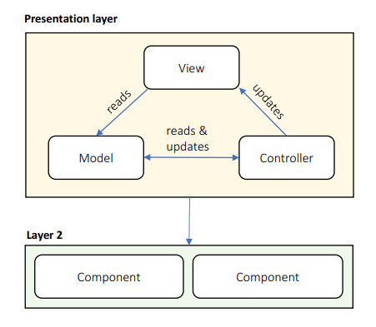
MVC In Presentation Layer - Hybrid
Presentation layer with MVC
Benefits of layers
With separation of concerns, presentation code scalability

Slide 159
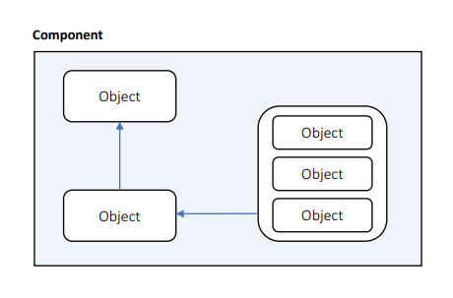
Objects In Components - Hybrid
Components contain objects
Benefits of components
With cohesion & extensibility
You are probably using this pattern already

Slide 160
Mixing of patterns
A software architecture is just a mixture of patterns
You can safely nest architectural design pattern inside of each other
For example:
Microservices with components inside them
Microservices with a layered pattern inside them
Create your own hybrid patterns and use them in your design
If the pattern works for you, implement it!

Slide 161
Questions for the learning system
We already chosen an application type and the technology stack
We need to pick architectural pattern and draw a diagram
1a. Choose an architectural design pattern. A great place to start is the layered pattern.
1b. Create a diagram with presentation, service, business, data and systemwide layers.
1c. Choose a pattern for the presentation layer. MVC? MVVM? Components?
2a. Consider authentication, caching, communication, configuration, logging, exceptions and validation.
2b. Consider all third-party tools to help you with these cross-cutting concerns.
3a. This is our first baseline architecture. Think about the components in the layers.
3b. Create diagrams for each layer and describe their public interfaces.
3c. Make sure you keep it simple at this stage. You can go into more detail in later cycles.
4. Design the business domain entities. Create a class diagram and define their public properties.

Slide 162
Choosing the right patterns

Slide 163
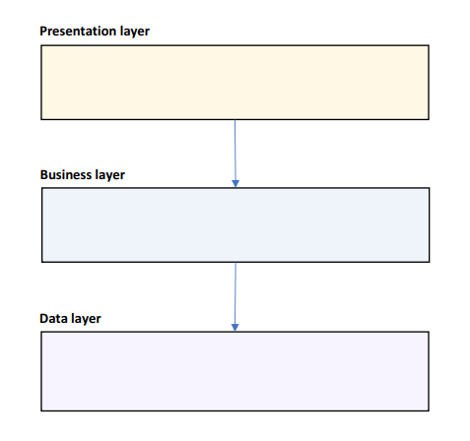
The Layered Pattern
Good starting point
Create 3 layers:
UI / Presentation – visualization concerns
Business – business logic and domain
Data – data access layer
If you expect a long-term project, you may choose Domain-Driven Design with Clean Architecture
Presentation – visualization concerns
Application – business logic
Infrastructure – infrastructure details
Domain – business entities
Add a Service layer if you plan to expose an API

Slide 164
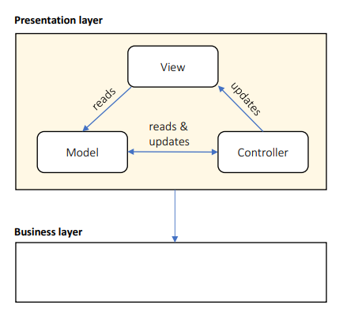
The Presentation Layer
Use Components for:
Containers
Reuse
3rd parties
Declarative rendering
Like WordPress – with widgets
Or with visual designer
Lots of dynamic interactions
Use MVC for lots of UI pages
Or MVVM if the technology support data binding
Remove this layer, if you designing an API
Without any UI

Slide 165
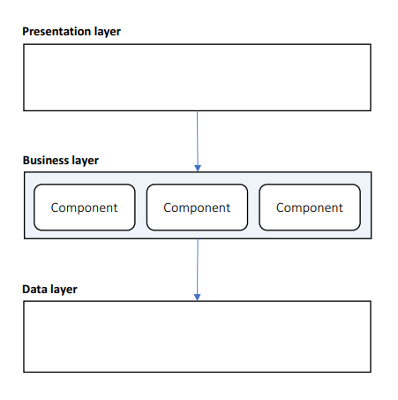
The Business Layer
Use Components:
Modular functionality
Plugin support
Business entity abstraction
For each entity – create a component
Declarative configuration:
Visual workflows – like a flow chart for the business rules
Business rules – collection of if/then/else rules
If you don’t need the above, use an object-oriented architecture

Slide 166
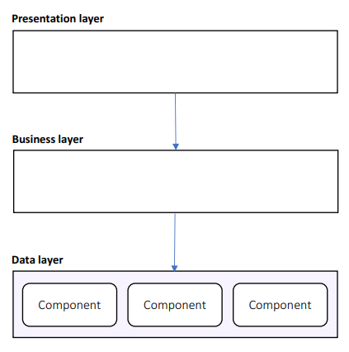
The Data Layer
Use Components:
Handling diverse data sources
SQL Server, Redis, MongoDB, etc.
Increased abstraction
Declarative configuration
Easily replace connection string, data storages and other mechanisms

Slide 167
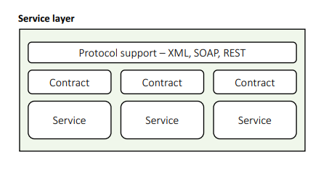
The service Layer
Use Components:
Contract management
Containers
Declarative configuration
Choose Microservices if your system is composed mostly of interlocking APIs
Never start with Microservices
Always choose a monolithic application with Microservices in mind
Use Domain-Driven Design and Clean Architecture to separate contexts
Extract microservices when necessary
Choose Message Bus if all services alter state on a common message

Slide 168
Designing Layered Architectures

Slide 169
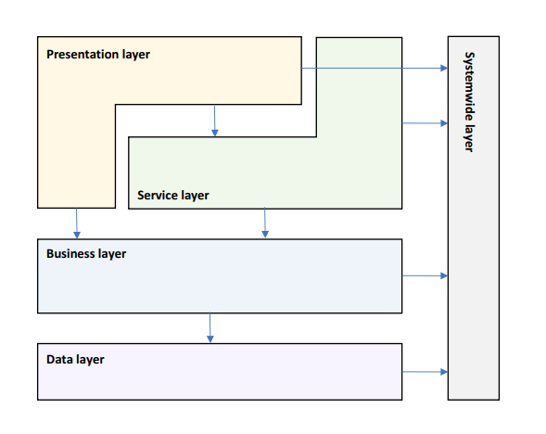
Logical Layered Design

Slide 170
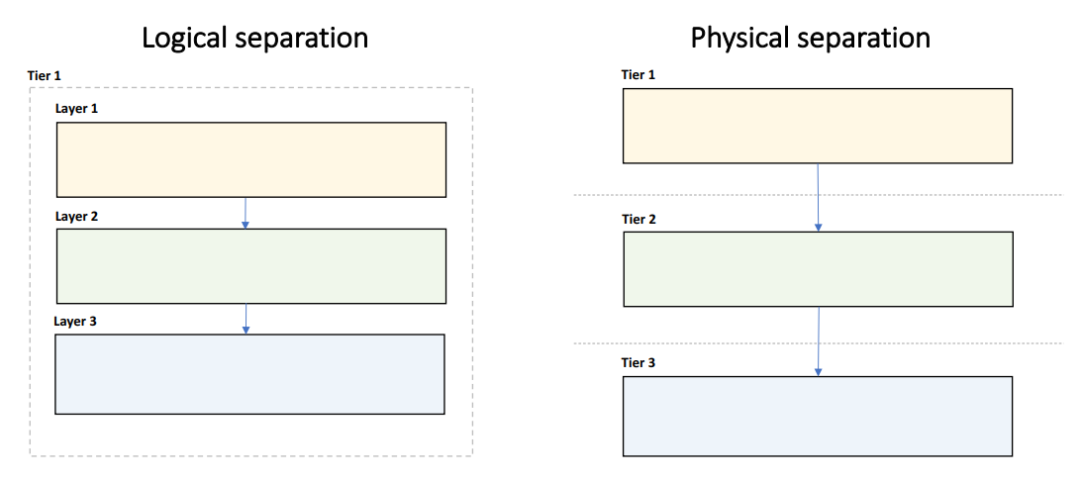
Choose Layering Strategy

Slide 171
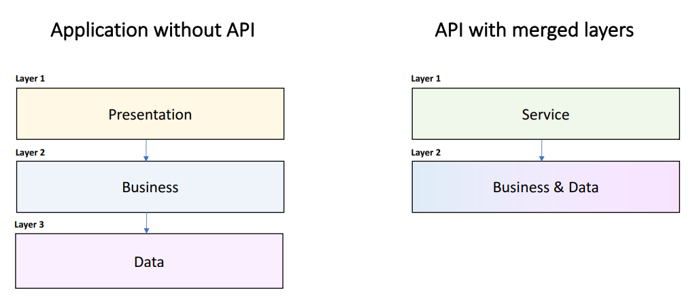
Remove & Merge Layers

Slide 172

Determine Layer Interactions

Slide 173

Identify Systemwide Concerns

Slide 174

Define Layer Interfaces

Slide 175
Designing Component Architectures

Slide 176
General Guidelines
Components are SOLID:
Single Responsibility
Open/Closed
Liskov Substitution
Interface Segregation
Dependency Inversion
Highly cohesive
Define clear naming rules
Classes, interfaces, methods, variable, constants, etc.
No knowledge of internals of other components

Slide 177
Design patterns
Design patterns are micro-architecture
Make sure your developers are familiar with them
Commonly useful design patterns:
Factory – remove the "new is glue" syndrome from your code
Repository – only if you really need it, may serve as anti-corruption layer
Façade – hide complexity in your business logic
Command – encapsulate actions in objects
Strategy – supports open/close principle
Learn all of them!
But use only the ones you need!

Slide 178

Presentation Layer Components
UI components
Presentation Logic
Views
Controllers
View Models
Optional:
Presentation entities

Slide 179

Service Layer Components
Services
Service Interfaces
Message Types
Data Transfer Objects
Optional:
Message Broker

Slide 180

Business Layer Components
Business Façade
Business Logic
Components
Workflows
Business Rules
Business Entities
Populated through ORM
Or data objects from data layer
Business Events

Slide 181

Data Layer Components
Data Façade
Data Source Adapters
Service Adapters
Optional:
Data Objects
Command & Query objects

Slide 182

Modular architectures

Slide 183
Designing Service-Oriented Architectures

Slide 184
Rest service
CRUD operations
Operates on Entities
Content negotiation
JSON, XML, HTML, Markdown…
Low overhead
Using web servers and HTTP
Request/Response
No discovery & routing
Incomplete standard
Fairly new

Slide 185
SOAP service
Any operations
Not limited to Entities
XML
High overhead
More interface layers
Request/Response, Fire & Forget, Bi-Directional Calls
Standard discovery & routing
World standard
You usually use it with older and legacy systems

Slide 186

The Service Design Process
Define data & messages
Define service contracts
Plan exception handling
Define how business entities are transformed to messages
Define how business functions are abstracted to services

Slide 187
Define Service Messages
Request/Response, Fire & Forget, or Bi-Directional
Command, Query, Document, Entity, Event, Message…
Avoid large messages
Add expiration & diagnostic info
Define in a Class Diagram

Slide 188
Define Service Contracts
CRUD or RPC
Stateful/Stateless
Transaction Management
Handle invalid calls:
Timeouts
Duplicate calls
Calls out of order
Define in a Component Diagram

Slide 189
Plan Exception Handling
Only catch what you can handle
Use meaningful messages:
Business explanation
Technical information
Retry instructions
Return fault metadata
Log everything
Notify exception subscribers

Slide 190
Define Business Entity Transforms
Transform entities to messages:
Reference Business layer directly
Use an Object Mapper
Use an Object-Relational Mapper
Use a Transform Language
Custom-built
Considerations:
Narrowing/Widening transforms
Flattening/Elevating transforms
Reversible transforms

Slide 191
Define Business Abstraction
Business layer abstractions:
Call the Façade directly
Call Business Components
(Re)Start a Workflow
Log a Business Event
Considerations:
Long-running workflows
State management
Transactions

Slide 192
Questions for the learning system
We can now move within a new cycle and create our first candidate solution
Objectives and key scenarios stay the same but let's refine the architecture
1a. Are we happy with our layers? Remove or merge layers? Their communication?
1b. Revisit the key issues and the system-wide layer. Are we happy with them? Our third-party tools?
2a. Are we happy with our presentation layer? Do we want to add presentation entities?
2b. Are we happy with our business layer? Choose a mapping strategy.
2c. Are we happy with our data layer and the level of abstraction?
3a. Start filling the service layer. Choose REST or SOAP. Choose exception handling strategy.
3b. Describe service messages. Create a new UML class diagram describing public properties.
3c. Describe the service contracts and their public interfaces.
3d. Decide how the service layer will communicate with the business components. 3e. Choose a transformation engine.
4. Bonus – forward engineer a skeleton solution.

Slide 193
Architecture quality attributes

Slide 194

Conceptual Integrity – Design time
Isolated layers and components
Application lifecycle management
How to manage updates
Healthy team collaboration
Awesome relationship with the Lead Developer
Design and coding standards
Automate the in your code reviews
Break away from legacy designs:
Façade pattern
Wrap as service
Rebuild from scratch

Slide 195

Maintainability – Design time
Isolated layers and components
Structured communication
Follow the same pattern for the whole solution
Consider a plugin system
Rely on platform features
Most modern languages have a lot to offer
Use systemwide layer
Add unit tests
Documentation

Slide 196

Reusability – Design time
Component-based architecture
Adhere to standards
General-purpose code
Your components should not be specific
Allow 3rd party software
You can buy tools to save time
Use a plugin system
Use systemwide layer

Slide 197

Testability – Design time
Design for testing
Allow mocking
Cover all layers
Automate case studies
Test:
Individual components
Entire layers
Collaboration between layers
Load, Security…

Slide 198

Usability – Design time
Elegant & simple UI
Implements all case studies in minimal number of interactions
Minimize the user interface interactions
Clear multi-step workflows
Ask for minimum number of information
Intuitive feedback
Especially for exceptions
Non-technical

Slide 199

Availability – Runtime
Tier failover
Use rate limiter
Limits the number of calls per second
Short-lived resources locks
Or no locks at all, if that is possible
Recover from exceptions
Do not kill an entire tier with a single exception
Update-friendly architecture
Handle network faults:
Offline support
Buffered proxy

Slide 200

Interoperability – Runtime
Data transformation
Keep systems separate
Adhere to standard:
SOAP
REST
XML/JSON

Slide 201

Manageability – Runtime
Health monitoring, logging, and diagnostic tracing
Consider a plugin or modular system
Much more flexible development
Declarative configuration
Add diagnostic tools:
Live tracing
Diagnostic notifications
Runtime log inspection
Runtime debugging
Dangerous so use it only in critical situations

Slide 202

Performance – Runtime
Buffered proxy
Async responses
The client gets immediate response with progress bar
Load-balanced tiers
Caching
Load tests
Minimize throughput:
Rate limiting
Design coarse interfaces
Minimize cache misses

Slide 203

Reliability – Runtime
Self-healing architecture
Use store and forward
Use alternative system if:
Primary system is offline
Primary system is very slow
Primary output is invalid
Replay messages when external resources come back online

Slide 204

Scalability – Runtime
Adding computer resources without any interruption
Tier scaling:
Scale up – increate resources
Single point of failure
Scale out – duplicate tiers
For stateless applications
The better approach
Handle load spikes:
Async responses
Store and forward
Allow stale data

Slide 205

Security – Runtime
Authenticate & authorize clients
Validate input & output
Encrypt sensitive data
Protect against:
Spoofing
Malicious input & output
Malicious use
Data theft
DDoS attacks

Slide 206
System-wide considerations

Slide 207
General guidelines
Always think about the big picture
Consider the following questions:
How will the system work under heavy load?
What will happen if the system crashes at this exact moment in the business flow?
How complicated can be the update process?
There could be more depending on the specific requirements of the system
Main concerns for the system architecture are:
Loose coupling
Stateless
Caching
Messaging
Error Handling & Logging

Slide 208
Loose coupling on a system level
Making sure our services are not tightly coupled to other services
Every time we change one process, another needs to follow
A good idea is to be platform independent
Do not use Java-specific communication, for example
Because the other service should also be written in Java
Also, the services should be URL independent
Imagine multiple services like in a typical application
They all communicate with each other
If one URL changes – massive issues
Possible solution – yellow pages service used for discoverability
Consul is a great tool for that purpose
Another solution – a gateway service to route requests

Slide 209
Stateless applications
Super important for scalability and performance
The application's state should be stored only in two places
The data storage
The user interface
No state is stored in application code
Typically, the user-specific data is the application state
Make it stateless
Why it is important?
Scalability - scaling out will be super easy
Redundancy – if one server fails, the other continue to work

Slide 210

Caching – What To Cache?
UI pages
Mainly useful for seemingly static information
UI components
These parts of the page which do not change often
Service output
Business Entities
Business State
Data query results
Configuration data
List data to be cached in each layer

Slide 211
Caching – definition
Caching is bringing the data closer to its consumer so that its retrieval will be faster
Cache options:
Client-side cache – using headers to store data in the client's machine
CDNs – using a content-delivery network for static assets
Service cache – caching in the application code
Cache types:
In-memory cache – size is limited but easily implemented (static concurrent collection)
Distributed cache – data is stored in separate process, slower performance

Slide 212
Caching – Where To Cache?
Local memory
The fastest
State server
File system
Database
The slowest
User standard solutions:
Redis
Memcached
Framework-specific caches

Slide 213
Caching – How To Manage The Cache?
Expiration strategy:
Time-based
Event-based
Flush strategy:
Manual
Automatic:
Least Recently Used
Least Frequently Used
Priority

Slide 214
Caching – How To Fill The Cache?
Proactive loading
Static data
Known update frequency
Known size
Reactive loading
Volatile data
Unknown lifetime
Large data volume
Fast caching medium

Slide 215
Messaging – definition
Messaging is the communication between the various services
Messaging methods are not exclusive
You can mix them easily
Messaging criteria:
Performance – faster methods are preferred
Size – small or large messages
Execution model – blocking or asynchronous
Feedback – whether the message has failed
Reliability – a message will be received even if there was a problem
Complexity – development effort

Slide 216
Messaging – rest API
The standard for HTTP-based systems
Messaging criteria:
Performance – very fast
Size – same as HTTP limitations
Execution model – request/response – bad for long processes, blocking
Feedback – immediate feedback
Reliability – retry policy should be implemented, the circuit-breaker pattern is great
Complexity – extremely easy
Useful for traditional web applications

Slide 217
Messaging – real-time communication
Using HTTP Web Sockets
Publish/subscribe, push notifications
Socket.io, SignalR
Messaging criteria:
Performance – very fast
Size – limited, no more than a few KB
Execution model – web socket connection or long polling
Feedback – fire & forget
Reliability – complex to implement proper reliable solution
Complexity – extremely easy
Useful for chat, monitoring, and real-time data

Slide 218
Messaging – queue
Services do not communicate directly
The first service pushes to a message queue
The second service pulls from the message queue
Messages will be handled once and only once + in order
Messaging criteria:
Performance – not so good, database persistence involved
Size – unlimited, but keep it small
Execution model – polling
Feedback – excellent feedback
Reliability – very reliable
Complexity – requires training and setup
Useful for complex systems with lots of data

Slide 219
Exceptions – Exception Strategies
Allow to propagate
Catch and Re-throw
Logging
Retains stack trace
Catch, Wrap, and Throw
Add metadata
Expose consistent exception types
Catch and Discard

Slide 220

Exceptions – Presentation Layer
Catch, display, and discard
Other layers should never discard exceptions
Attempt to retry
Automatic 3 retries or manual
Switch to secondary system
Alert by Email, SMS, Slack…
Use meaningful messages
Business explanation
Technical information
Steps to resolve

Slide 221

Exceptions – Service Layer
Catch and Re-throw
Attempt to retry
Switch to secondary system
Log exception and input message

Slide 222

Exceptions – Business Layer
Catch, Wrap, and Throw
Use custom exception types
Provide business context
Rollback transactions
Log exception and input arguments
Broadcast to subscribers

Slide 223

Exceptions – Data Layer
Catch and Re-throw
Log exception and input query

Slide 224

Logging - definition
Logging has two purposes:
Track errors
Gather data
Which module is most visited
Performance scenarios
User's flow
Log storage doesn't really matter
As long it is useful
Files
Database
Event log
Good architectures always includes logging and monitoring!

Slide 225
Logging – best practices
Use a central logging service
Same log format
Same log data
Same log location
Implementation:
Expose an API
Watch specific folders for log files and collect them
Tools like Logstash are perfect for that
Use Correlation ID
If you have multiple services in a flow
Make sure you can link different log entries
You can easily track a complete flow

Slide 226
System-wide attributes
The concepts we covered in this section are super important
They should be part of every single system out there
They allow you to have a fast, secure, reliable, and maintainable solution
Make all choices as informative and early as possible
Many concepts are difficult to replace once made
Changing a REST API with a message queue is not an easy and cheap task
These concepts are not exclusive
Although they are the most important ones
A lot of research should be done for every single system
No tool is a golden hammer

Slide 227
Deployment considerations

Slide 228

Deployment Models

Slide 229
Distributed Deployment Guidelines
Minimize blocking calls:
Async calls
One-way calls
Buffering
Use distributed transactions
Use coarse-grained interfaces
Manage state:
Stateless design – highly scalable
Stateful design – supports workflows but doesn’t scale
Shared state server

Slide 230

Deploy For Performance
Business/data layers scale out
Can detect failed tiers
Stateless design preferred
Stateful design requirements:
Shared state server
Session affinity

Slide 231

Deploy For Reliability
Secondary tier takes over when primary tier fails
Requires way more hardware
Synchronization considerations:
Sync when secondary tier activates
Or allow stale data

Slide 232

Deploy For Scalability
Data replicated on multiple tiers
Replication breaks consistency and atomicity
Consistency considerations:
Delayed sync in background
Or allow stale data
Or partition data

Slide 233
Scale Up And Scale Out
Scale Up
Easy with VMs or containers
But limited results
Scale Out
Requires layered design
Requires partitioned data
Potentially unlimited

Slide 234
Questions for the learning system
We still haven't thought about performance, availability, and scalability
1a. What is our tiering strategy? Scaling up or scaling out?
1b. What is our redundancy and failover strategy?
1c. Write down a load test and validate the scalability? What can we do to improve it?
2a. Is our business layer stateless? What is our state management policy?
2b. Think about all the data in our system. Where can we introduce caching?
2c. Where are we going to store the cache? How are we going to warm it up?
2d. Think about the exception policy for each layer. Consider a third-party logging tool?
3. Do you think you can easily debug problems in your solution? If no, redesign it.

Slide 235
The architecture document

Slide 236
Definition
Table of contents
The requirements of the system
Functional and non-functional
The technology stack
The architecture diagrams
And many more sections
Do not start development without this document!
Audience – almost everyone involved
Project manager
CTO / CEO
The Developers
The QAs

Slide 237
audience
Management
The requirements reflecting the essence of the system
Executive summary describing best practices and modern patterns
Architecture should be geared towards business goals
Management’s sections appear first
Development team
Technology stack
Modules, services, communication
Other technical details
QA team
Testing infrastructure
Servers, testing tools, coding

Slide 238
Format of the document
The format of the document is subject to hot debates
There are standards but nothing is set in stone
You can use UML, but it is not necessary
Sometimes you may skip it, if the audience is not familiar with it
Keep it as simple as possible
Use plain and simple English
Keep the technical details for the developers
Get into the minds of your readers
Visualize using software you are comfortable with

Slide 239
Main structure of the document
Background
The role of system from a business perspective
Requirements
These dictate the whole architecture
Executive Summary
High-level overview of the solution – for non-technical readers
Architecture Overview
The technical big picture of the solution
Module Drill-Down
The core of the document
Detailed and practical instructions for implementing the architecture

Slide 240
Background section
Describes the system from a business point of view
System's role
For example – solution for the HR team
Reasons for replacing an old system
For example – too much maintenance and old technologies
Expected business impact
For example – increasing HR productivity by at least 20%
Validates the architect's point of view of the system
Maximum 1 page
If there is an error, you can easily correct it
All next sections build upon this one
Boosts your confidence in front of the management
Therefore, you do not use any technical words here

Slide 241
Requirements section
This section should again be maximum 1 page
Keep it brief
Use bulleted lists for describing the requirements
Functional – what should the system do
Non-functional – what should the system deal with
Validates your understanding of the requirements
Whatever you design, it will solve the actual problem of the customer
The architecture is designed against well-defined requirements
It is a high-level overview of the requirements
Do not take the job of a functional analyst ☺

Slide 242


Requirements section example

Slide 243
Executive summary section
This section should be around 3 pages
This section is again for the management team
They will not read your whole document because usually they do not have the time
So, you need to impress them and present yourself as good solution architect
You need to make them believe that their system is in good hands
You need to provide a high-level nontechnical view of the architecture
Get into your readers' mind!
A person who does not have a lot of time available
He or she should be satisfied as quickly as possible with the presented solution
Use charts and diagrams (+ well-known technical terms)
Write this section after you write the rest of the document!

Slide 244
Architecture overview section
This section can reach up to 10 pages
Presents the architecture from a technical point of view
This section should not deep dive into independent modules
It just layers the foundation for these modules
Include these three subsections:
General description - type of the application and major non-functional requirements
High-level diagram – show the separate modules and their connections logically
Do not mix physical hardware here
Diagram walkthrough – describe various parts of the architecture and their roles verbally
Use simple words and include the most relevant details
Include technology stack here only if you use the same stack in each module

Slide 245

Architecture overview diagram example

Slide 246
Modules drill-down section
This section can have "unlimited" number of pages
You should add for each module in huge detail:
Component's role
Technology stack
Data store, back-end, front-end, etc.
Be extremely detailed here and always include rationale!
But only for the first module of a particular technology!
Module's architecture
The inner architecture of the module
What exactly and the module should do and how
Include layers, diagrams, design patterns, etc.
Describe the API and method names
Development instructions – keep it brief

Slide 247
designing a solution

Slide 248
Our main tasks
Here are our main tasks as solution architects in a nutshell:
Understand the system’s requirements
Understand the non-functional requirements
Identify key scenarios and map baseline modules and layers
Select the technology stack
Design the architecture
Write the architecture document
Support the Lead Developer and the team ☺

Slide 249
Real-world project
In our previous sample project, we analyzed the process in a huge detail
And it was more of a demo project
Let us analyze a real-world application
Our project works with lots of IoT devices
Home cameras and thermostats, for example
Each of these devices has a separate application to control it
But we want to have a unified view of all our registered ones
We should collect status information and format the data to visually pleasing dashboard
This way the customer will know what is going on with all his/her devices

Slide 250
Functional requirements
For our first version the data is read-only and just visualized
Customers cannot update data directly from the application
Customers and their devices are pre-validated because of security protocols
Customers do not need to register in the application
Functional requirements
The Functional Analyst did a good job
We should understand the concept of the system
Receive status updates from IoT devices
Store the updates for future usage
Allow the users to query the updates

Slide 251
Non-Functional requirements
Think for a minute – what are the non-functional requirements of this system?
What information can influence our architecture?
What kind of questions we need to ask our customer?
What we know:
Messages are from IoT devices – there should be a huge amount of messages
What we should ask:
Load - how many concurrent messages should the system expect at peak times?
Volume - what is the total number of expected message per month?
Size – what is the average size of a message?

Slide 252
Client Answers
After a few days of thinking, the client answers:
Maximum 500 concurrent messages at peak times
15 000 000 total number of message per month
300 bytes is the average message size
Let's do some data volume calculations:
15 000 000 x 300 bytes = 4 500 MB / month
4 500 MB x 12 months = 54 GB / year
Almost every database can handle this volume of data easily
Usually in data extensive applications – the data can expire
But we do not think about data archiving or deleting here
Data volume doesn't seem to be a problem here

Slide 253
But what about load?
500 concurrent messages is a super busy system by any standard
We can easily add lots of servers and scale out
But such solution costs money
It is a better solution to design the software so that it can handle such load
There is one more concept we need to think about
Do we care about losing messages?
If we think about it – no. If a message is lost, a new one will be send in a couple of seconds…
Our system is quite tolerant for message lost
Of course, we are not talking about system-wide catastrophe
1 lost message out of 1000 is completely acceptable (99.9%)

Slide 254
users
The next requirement is about users
How many users will the system have?
Total of 2 000 000 users
How many concurrent users should we expect?
No more than 40 concurrent users
Users who are actively accessing the server
Total load calculated – 540 concurrent requests

Slide 255
Service level agreement
Of course, the client expects 100% uptime
But that is not possible in even the most advanced data centers
There are a lot of factors and we do not have control over them
Hardware, virtualization, network, database servers
In such cases – make sure you communicate with the proper people
When talking with the client, you can define three levels of software SLA
Silver, Gold, Platinum
You decide the differences but the best one is
Fully stateless
Easily scaled out
Logging & monitoring
We have live data here, so we choose the Platinum level

Slide 256
Requirements conclusion
Functional:
Receive status updates from IoT devices
Store the updates for future usage
Allow the users to query the updates
Non-functional:
Data volume: 54 GB annually
Load: 540 concurrent requests
Message loss: 0.1%
Total users: 2 000 000
SLA: Platinum level

Slide 257
Mapping baseline Modules
Modules are based on the requirements
We have two separate tasks working with separate entities
Receiving and storing status updates
Querying these status updates
We can distinguish two different modules
Receiver – to receive the messages
It will work on heavy load, so we need to make sure it will not have a thread starvation
Info Provider – to provide information to the end-users
But there is a question here…
Do we directly store the messages in a raw format?
Or do we validate them first?

Slide 258
Mapping baseline Modules
We ask the client, and the answer is:
There are 4 types of devices and formats
3 of them are JSON-based and one of them is a plain string (needs parsing)
Validation is required
We now know the receiver has the following tasks:
Receive the message
Validate the message
Parse the message and convert it to a unified format
Store the message
But the receiver is under heavy load, its request processing should be as fast as possible

Slide 259
Mapping baseline Modules
The parsing task is super important
It will make our data independent from its source
We will have easier queries for the dashboard
Having unified format is a good solution when data is from multiple sources
So, we decide to leave the receiver do just that – receive
For the other tasks – we need additional modules
We can add a Validation module to our architecture
But who should do the parsing? It is a good question…
Since validation and parsing always go hand in hand, we can do them in a single module
There is no justification to split the tasks in different modules for this scenario
Because they will require maintenance

Slide 260
Mapping baseline Modules
To summarize, we defined the following modules:
Receiver – receives messages and dispatches them
Handler – validates, parses and stores messages
Info Provider – gives us the option to query the messages
We can now add one more system-wide module:
Logging – the central logging service for all the other ones
Finally, we need a Data Store module
It should be shared between the Handler and the Info Provider

Slide 261

Choosing messaging methods
Our service modules look like this:
What kind of messaging is the right one between each one of them?

Slide 262
Choosing messaging methods
Let us begin with the Receiver:
It receives messages from the IoT devices but how?
We ask the client for device specification and we see that the IoT devices use HTTP POST requests – REST API then
But here is the tricky part. How to send the data to the Handler?
It should be done as quickly as possible to relieve the load of the receiver
The obvious mechanism here is a message queue
Provides us order of execution and reliability
If we use REST, we will block the working thread – it will be waiting for a response
Additionally, we will have to handle errors and glitches
Hurting the performance by a lot!
The fire and forget approach is perfect!

Slide 263


Choosing messaging methods
Popular queue options:
Self developed
Never developer your own message queue except in single-process applications
RabbitMQ
General purpose message broker
Easy to setup
Easy to use
Kafka
Stream processing platform
Perfect for data-intensive applications
Very complex installation and setup

Slide 264
Choosing messaging methods
What about Info Provider?
That one is easy – the answer is lies within the end-user requirements
How are they using the system?
Via a web browser
And web browsers use HTTP
The Info Provider will implement a REST API for the end-users
Last, but not least – the Logging service
We have large amounts of records – REST API will hurt the performance a lot
We could use file polling, but this solution is not cloud compliant and it is hard to control
We can use a database or a queue. Which one is better?
In this situation – a queue
Just because the database will be used as a queue in this scenario

Slide 265

Choosing messaging methods

Slide 266
Designing the logging service
Our architecture is now ready!
Just make sure the client's IT support understands the queue mechanisms!
Our next task is to design the Logging service
It is super important, and it should be treated as a first-class citizen
Besides that – the other services need it
These are the steps:
Design the application type
Design the technology stack
Design the architecture

Slide 267
Designing the logging service
What are the tasks of the Logging service?
Read log records from the queue
Handle the log records
Save in log data store
The Logging service is not based on HTTP, so we do not need a web application
It is not a mobile or desktop application… But is it a console one?
Console is a good fit for long-running applications with limited UI
What about a service? Well, service is also a good fit
The choice is between a console or a service application
It depends on personal taste, so both are fine

Slide 268
Designing the logging service
Let us design the technology stack
Module's code and the data store
Access queue's API
Store data
All technologies provide a solution to these stacks, so we consider our developers' skills - .NET Core and SQL Server, for example
Any combination will work here – Java and MySQL, Python and PostgreSQL, etc.
For operations with lots of writes and less updates, we may consider a wide column or document database here

Slide 269

Designing the logging service
Let us design the service layers
Does the classical 3-tier architecture fit?
UI/Service interface
Business logic
Data access
It fits, but we do not have UI here, so let's change it a bit:
Polling
Business logic
Data access

Slide 270
Designing the logging service
We need to specify the responsibilities:
Polling – polls the queue every few seconds for new log records
Business logic – all new log records are sent here for validation
Data access – if everything is ok with the log records, this layer saves them to the database
Other developer instructions:
Use dependency injection – Microsoft.Extensions.DependencyInjection for our .NET case
Use ORM for data access – Entity Framework Core for our .NET case

Slide 271
Designing the Receiver service
What are the tasks of the Receiver service?
Receives messages from the IoT devices
Sends messages to the queue for the Handler
What kind of application is this service? It is an easy one – web application
What is the technology stack?
If we chose .NET Core for the Logging service, we need a very good reason to use another stack as it can create a lot of headaches
The question here is - does .NET Core support REST API?
Yes, it was built for that!
As a bonus point – we receive superb performance!
There is no reason to change the technology!

Slide 272

Designing the receiver service
Let us design the service layers
Does the classical 3-tier architecture fit?
UI/Service interface
Business logic
Data access
It fits, but we do not have a data store, so let's change it a bit:
Service interface
Business logic
Queue handler
With these two examples you can see why the layered architecture is so flexible!
Just work with interface contracts and you are great!

Slide 273

Designing the receiver service
There is one more thing here
We need a cross-cutting concern – logging!
It should receive logs from every single layer
Remember exception handling for the various separations?

Slide 274
Designing the receiver service
Let us look back at our non-functional requirements for validation
Two of the non-functional requirements are relevant here
Load is 500 concurrent messages. Are we compliant?
Yes! Our service is stateless, simple, and easily scaled out in front of a load balancer
Message lost is 0.1%. Are we compliant?
Yes! Our service is super simple and uses a reliable REST API protocol
As a side note – for a better uptime, we should consider a cloud technology
This service is done
We can add additional developer instructions about library usage, for example

Slide 275
Designing the Handler service
What are the tasks of the Handler service?
Polls messages from a queue
Validates messages
Parses messages
Stores messages in data store
What is the application type?
No HTTP and UI are required
A good choice is a service application
There are no special requirements so we can use the same technologies
.NET Core and SQL Server in our example

Slide 276

Designing the Handler service
Let us design the service layers
As with the Logging service, we do not need a service interface
So, our first layer will be named Polling
Because it polls data from the queue
For the Business Logic layer, we can add a plugin mechanism
To easily add validation and parsing logic
If new devices with new formats are added in the future
Of course, we need a cross-cutting concern - logging

Slide 277
Designing the Info provider service
What are the tasks of the Info Provider service?
Allows end-users to query the data store
The service is responsible only for data retrieval (it does not display the data)
The application type is easy
A web application with REST API
There are no special requirements so we can use the same technologies
.NET Core in our example

Slide 278

Designing the Info provider service
Let us design the service layers
Does the classical 3-tier architecture fit?
UI/Service interface
Business logic
Data access
Yes, it fits perfectly, just add logging!
But that is not all, we need to design the API
We did not do it in the Receiver service, because the method was dictated by the devices

Slide 279
Designing the Info provider service
After discussing with the client, the end-users need the following:
Current status of their entire house and for specific devices
Past events for their entire house and for specific devices
Required functionality:
Get all the updates for a specific house’s devices for a given time range
Get the updates for a specific device for a given time range
Get the current status of all the devices in a specific house
Get the current status of a specific device
The three main factors for our API are:
Path
Status code
Content

Slide 280
Designing the Info provider service
A sample functionality will be:
Get all the updates for a specific house’s devices for a given time range
The time range is not part of the path because it is not an entity
The status codes should be:
200 OK, if the data is successfully returned
404 Not Found, if the "houseId" could not be found
The response content should contain all the necessary information for the clients
GET /api/house/houseId/devices/updates?from=from&to=to

Slide 281

Designing the Info provider service

Slide 282
Writing the architecture document
We need to write an architecture document
Background
Requirements
Overall architecture
Module drill down
Executive summary
There is one provided in this workshop
Contains everything we discussed
You may use it as a template, if you like
We are done with this project! Great job!

Slide 283
what’s next?

Slide 284
This workshop covers a lot!
We now know a lot of patterns
But the software development world is an ever-changing one
I am going to mention some other currently used patterns
You will not use them in every system but just keep them in mind
Use them when you think they will be relevant
Most of these patterns require a separate workshop
And I will do one in the future ☺

Slide 285
Microservices
The microservices pattern is quite popular today
Basically, microservices mean logically distributed data
It comes with a lot of challenges and technical difficulties
It is a huge trend but do not board that train in a hurry
The big companies use microservices because they need them
Consider various other solutions first
And the best approach is to start with a domain-driven designed solution and extract microservices later when you need them
There is a bonus video in this workshop about microservices

Slide 286

Microservices
In monolithic architecture:
A single exception may crash the whole process
Updates impact all the components
Limited to one dev platform
Unoptimized compute resources
With microservices:
Each service runs in its own process and does not impact other services
Each service can be updated separately
Each service can be implemented using different platform
Each service can be optimized separately

Slide 287

Microservices
Additional complexity:
Complex monitoring
Complex architecture
Complex testing
Complex deployment
Complex data consistency
You need eventual consistency patterns
Like the Outbox pattern
There is a bonus video about it

Slide 288
Event sourcing
Instead of updating entities, you save the update event and what was changed
Pros
Tracing – you can track everything quite easily
Data Model – super simple, no complex entities
Performance – changing state is add a small record
Reporting – a lot of business reports require data history
Cons
No unified view of entities – it takes time to build some visualizations
Storage – a lot of storage is required for all the data

Slide 289

Event sourcing
Mostly implemented where data history matters
Think about your bank account statement – you see events, not entities
Learn more about event sourcing
https://martinfowler.com/eaaDev/EventSourcing.html

Slide 290

CQRS
Stands for Command Query Responsibility Segregation
It means that we write data to one database
We read data from another
And there is a process to synchronize the two databases
Sounds strange at first, but it complements very well the Event Sourcing pattern
Useful with high frequency updates that require near real-time query capabilities for the price of complexity

Slide 291
Containers
Another great pattern is using containers
Docker is the most popular approach
You wrap your application in a read-only image
It gives you environment consistency and easier deployment
Containers often need orchestration
Docker Swarm or Kubernetes are great tools
There is a video lecture about Docker

Slide 292
Serverless computing
Emerged with the clouds
You may exclude the back-end development
And rely on deployed functions in the cloud
Allows easier scaling and implementation without an architecture
It is more difficult to debug
Azure Functions and AWS Lambda are great providers

Slide 293
Security
Customer data should be protected
And should not be shared with external services or users
Sensitive data should be protected
Payment cards, for example
Anti-breach mechanisms
There are a lot of factors regarding security
It is a huge topic and I plan to create a workshop for it ☺

Slide 294
Learn by yourself
We covered a lot!
But the topic is endless!
Google how to become a good software architect!
Improve yourself daily!
Work on your soft skills!
Excellent communication is as valuable as computer knowledge!
Keep in mind this field changes very quickly!
New design patterns come and go!
Frameworks are changing all the time!
New libraries are released every day!
The whole IT landscape is constantly evolving!

Slide 295
FINAL Lecture WORDS

Slide 296
Exclusive workshop partner – lab08
Lab08 offers product development services
The company works with clients from the Scandinavian market, developing web platforms in various domains
Video-based user testing
Issuance and verification of digital credentials
Marketing through gamification and influencer-based social media marketing
When a Lab08 employee seeks development - the person can move on to a new product or domain within the company, being able to explore the product area in depth
Careers: https://lab08.com/careers/

Slide 297
Code It Up Mentorship program ON Patreon
Target – junior to regular programmers with 0 to 2 years practical work
Help with:
Becoming better software developers
Code improvement in terms of quality and logic
Career choices and advancement
Interview preparation
And more
Approach – private groups, exclusive lessons, live classes, one-on-one meetings
From 2021 – project mentorship – DDD, Microservices, CI/CD, Kubernetes, and more
More information on Patreon: https://www.patreon.com/ivaylokenov

Slide 298
Lecture summary
About Code It Up
About This Workshop
Why Software Architecture
The Architect And The Team
What Makes A Great Architect
What Is Software Architecture?
Unified Modeling Language
Designing Solution Architectures
Common Technology Stacks
Architecture Design Patterns
Choosing The Right Patterns
Architecture Quality Attributes
System-Wide Considerations
Deployment Considerations
The Architecture Document
Designing A Real-Life Solution

Slide 299
Any Questions?

Slide 300
Your Turn Now!
Download the resources from here and start the book: https://bit.ly/software-architectures
Ask questions on sli.do:
https://sli.do #softarch
Use the Facebook group for questions after the event:
https://www.facebook.com/groups/codeitup/

